Slide 1
ESG – “It’s Worth the Effort”
Kim Crawford, Chris Battle, and Lisa Worth
ESG Homeless Program Coordinators
Amanda Mason
First Tier Consulting
May 22, 2019

Slide 2
Purpose of the Emergency Solutions Grant (ESG)
ESG funds are intended to be used as part of a crisis response system using a low barrier, housing-focused approach to ensure that homelessness is
“rare, brief, and one time.” (Matthew Doherty, USICH)
Engage homeless individuals and families living on the street;
Improve the number and quality of emergency shelters for homeless individuals and families;
Help operate emergency shelters;
Provide essential services to emergency shelter residents,
Rapidly re-house homeless individuals and families
Prevent families and individuals from becoming homeless.
2019 “Bringing it Home” Homeless Conference

Slide 3
Eligible Activities
Emergency Response
  Street Outreach
  Emergency Shelter (Operations and Services)
Housing Stabilization
  Targeted Homelessness Prevention
  Rapid Rehousing (Housing Relocation & Stability Services and Financial Assistance)
HMIS and Domestic Violence Comparable Database
Administration
2019 “Bringing it Home” Homeless Conference

Slide 4
ESG Priorities, Policies, Procedures
  Coordinated Entry: Does the agency actively participate in the coordinated entry process providing access to all demographic groups?
  Written Standards: Does the agency follow the written standards established by the CoC and promote the CoC priorities and goals?
  Planning/Coordination - Has the agency participated in at least 75 percent of the community meetings contributing to the homeless discussion?
  Housing First/Low Barrier: Is the agency committed to moving towards operating under a housing first / low barrier model?
  VAWA: Is the agency an active participant in the CoC’s established VAWA process?
2019 “Bringing it Home” Homeless Conference
Notes:
Thoughts to consider

Slide 5
“It’s Worth It!”
2019 “Bringing it Home” Homeless Conference

Slide 6
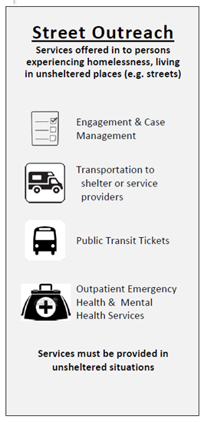
Emergency Response
Triangle Family Services
Alice Lutz
2019 “Bringing it Home” Homeless Conference
Notes:
Why did the organization apply?
What has it done for the organization & impacted homeless in your community
Why was it worth it?
Application Process (RFA)
Paperwork/Program Documentation

Slide 7
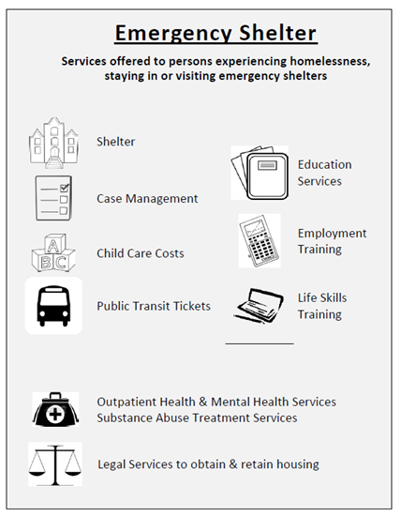
Emergency Response
Union County Community Shelter
Melissa McKeown
Urban Ministries – Wake County
(New Subrecipient)
Lisa Williams
2019 “Bringing it Home” Homeless Conference
Notes:
Why did the organization apply?
What has it done for the organization & impacted homeless in your community
Why was it worth it?
Application Process (RFA)
Paperwork/Program Documentation

Slide 8
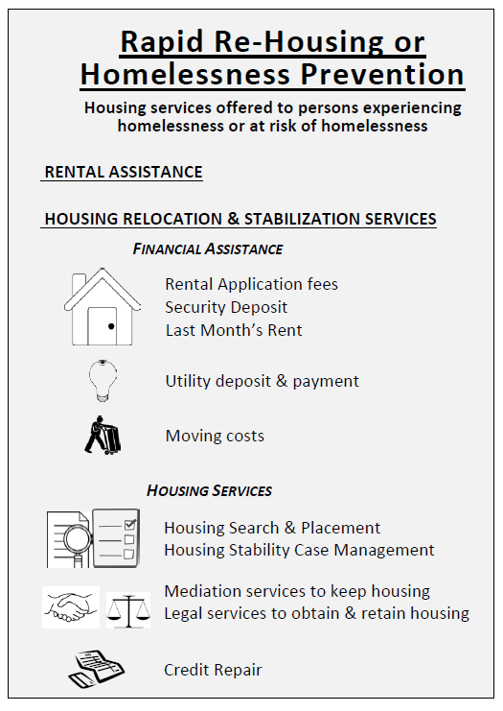
Housing Stabilization
Rapid Rehousing:
Pitt County
Lynne James
Deloris Farmer
Homeless Prevention:
Homeward Bound - WNC
Leigh Hackney
2019 “Bringing it Home” Homeless Conference
Notes:
Why did the organization apply?
What has it done for the organization & impacted homeless in your community
Why was it worth it?
Application Process (RFA)
Paperwork/Program Documentation

Slide 9
Q & A
2019 “Bringing it Home” Homeless Conference

Slide 10
Contact Information
Kim Crawford
ESG / Homeless Programs Coordinator
Division of Aging and Adult Services
North Carolina Department of Health and Human Services
919-855-4991 office
Kim.Crawford@dhhs.nc.gov
Chris Battle
Homeless Programs Coordinator
Division of Aging and Adult Services
North Carolina Department of Health and Human Services
919-855-4984 office
Chris.Battle@dhhs.nc.gov
Lisa Worth
Homeless Programs Coordinator
Division of Aging and Adult Services
North Carolina Department of Health and Human Services
919-855-4993 office
Lisa.Worth@dhhs.nc.gov
2019 “Bringing it Home” Homeless Conference

