Slide 1
Transitioning to OAT
SOAR Data in North Carolina

Slide 2
Current NC System
NC currently uses our own outcome reporting system
  1 of only 2 states that are hold outs
  Mecklenburg pilot
SOAR trained case managers submit via
  Fax
  Email
  NCCEH webpage
All of our state data sits in an Excel spreadsheet
Sarah creates reports monthly for state and each county
Sarah creates other individual reports per request

Slide 3
OAT System
All SOAR trained case managers submit the same way
  Web based database
  Must have access to internet to submit
  Must remember login (or set computer to remember)
All of our state data moving forward would sit on a secure server
Sarah would still publish monthly reports on website
Each case manager would have access to run their own reports
  And those of others if an agency or local lead

Slide 4
Current NC System
Walk through: https://www.ncceh.org/soar/communityoutcomes/

Slide 5
Oat System
Registration and overview

Slide 6
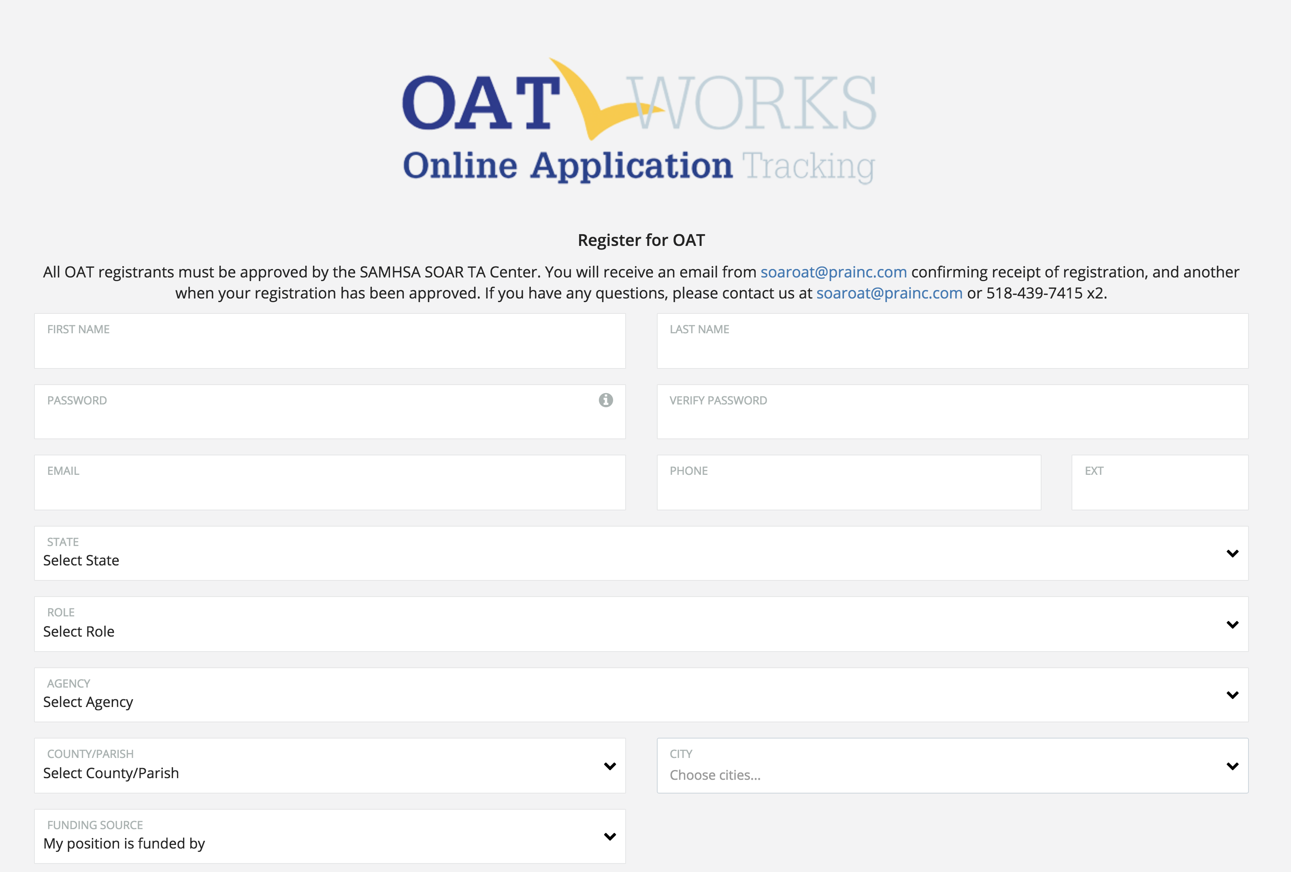

OAT Registration
Track outcomes and get funding!

Slide 7
Roles in OAT
State Team Lead
  Directs the SOAR initiative at the state level; has access to data from all agencies in the state.
Local Lead
  Oversees multiple agencies in a community, county or region; has access to data from multiple agencies in the specified service area.
Agency Lead
  Oversees multiple case workers in an agency; has access to data from all caseworkers in that agency.
Caseworker
  Works with applicants and enters data into OAT on his/her application outcomes. Has access to their data only.

Slide 8
Oat System
Walk through: https://soartrack.prainc.com/login.php

Slide 9
Pros
Similar questions to NC reporting system (likely low learning barrier)
Better able to track housing, employment, Medicaid, etc
Would likely make TA easier
Data more accessible outside of NCCEH
Case managers can use as an organizational tool before decision reached (won’t forget what you’ve submitted)
State data is more secure
Strong support from National SOAR TA Center (guides, IT support)

Slide 10
Cons
Not a way to enter past state data so main benefit is moving forward
Another login to remember (and must register)
Some case managers may not like agency or local leads having access to data
Subject to SAMHSA regs for any changes (demographics)

Slide 11
Thoughts and Questions

