Slide 1


QUICK GUIDE TO APPLING FOR MEDICAID
Aged, Blind, and Disabled

Slide 2
OBJECTIVES
Understand the methods of submitting applications and documents to the local DSS agency.
Understand the basic eligibility factors and programs for the Aged, Blind, and Disabled.
Understand how to best overcome the main obstacle faced when assisting applicants who are homeless or at risk of homelessness when applying for benefits.
Understand the applicants right to request an appeal

Slide 3
INTRODUCTION
When a Medicaid application is received by the county DSS, the applicant is evaluated for eligibility in all coverage groups. It is our goal to approve all benefits across various programs for which an applicant is entitled.
With current technology, there are multiple ways the local North Carolina DSS agencies can receive applications and documents to better serve our community.

Slide 4
APPLYING FOR MEDICAID
The type of contact made by the individual determines the procedure the local agency must follow. An individual or representative may apply at any local agency by any mode that an application may be submitted.
PROCESSING TIMEFRAMES
The application processing time standard for Medicaid Assistance to the Disabled (MAD) is 90 calendar days. Application processing time standard is 45 calendar days for all other Medicaid programs, including NCHC.

Slide 5
HOW TO SUBMIT AN APPLICATION
Medicaid applications may be submitted:
In-person
Mail/fax/email
Telephone
Online: ePASS
Healthcare.gov
      LIS transmittal through Social Security
      DSS All Access App

Slide 6
IN PERSON
Due to COVID-19, our lobbies are currently closed. In person, face-to-face interviews are currently not being completed.
Customers still have the option to pick up or drop off an application at both agency locations:
  Kuralt Centre - 301 Billingsley Road, Charlotte, NC 28211
  Community Resource Center (CRC) - 3205 Freedom Drive, Suite 1000, Charlotte, NC 28208
A case manger will contact the applicant/beneficiary or their authorized representative by phone to complete the interview.

Slide 7
BY MAIL/FAX/EMAIL
An individual may submit an application by forwarding to the local agency a DMA-5200 / DMA-5200S, Application for Health Coverage & Help Paying Costs.
A drop-off is considered a mail-in application.
An individual may contact the local agency and requests an application be mailed to them.
Mecklenburg County Department of Social Services
Customer Connection: 704-336-3000
An individual may submit an application by faxing to the local agency a DMA-5200 / DMA-5200S, Application for Health Coverage & Help Paying Costs.
Mecklenburg County Department of Social Services
The agency general fax number: 704-353-1325

Slide 8
BY MAIL/FAX/EMAIL
A complete application is one that meets the following criteria:
The information provided is legible.
2. The application is signed by the individual applying or signed by a representative.
3. The application includes:
  a. The name and date of birth of at least one applicant, and
  b. Mailing address
If any items above are missing, this is considered an incomplete application.

Slide 9
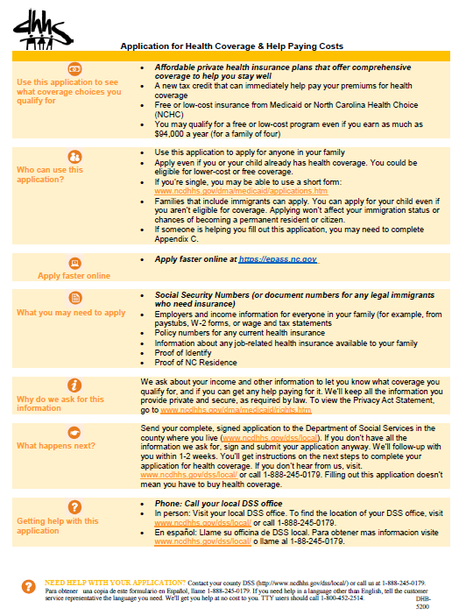
DHB-5200
Medicaid is a program to assist eligible aged, disabled, blind individuals with the cost of medical care. Potentially eligible customers range from disabled or blind children to adults.
DHB-5200-ia Application for Health Coverage &
Help Paying Costs
https://policies.ncdhhs.gov/departmental/forms

Slide 10
TELEPHONE
An individual may apply for Medicaid/NCHC by telephone. The date of the application is the date of the telephone interview. The local agency must have staff available to complete telephone applications the same day the request is received. The case manager must complete the entire application over the telephone and enter it into NCFAST during the telephone interview.
Currently, North Carolina is not set up to receive telephonic signatures.
  A case manager will mail the signature page of the application the same day the application was submitted into NC FAST.
  The DMA-5097 / DMA-5097S, Request for Information, and the signature page of the application will be mailed to the applicant.
  If the signature page is not returned by the processing due date, the application will be denied.
Mecklenburg County Department of Social Services
Customer Connection: 704-336-3000

Slide 11
ONLINE – EPASS
An individual may apply for benefits online through ePASS (Electronic Pre-Assessment Screening Service).
ePass is a secure, web-based self-service tool that allows individuals to submit a Medicaid/NCHC application online:
  1. ePASS allows the applicant to do a pre-assessment to determine if the individual is potentially eligible for medical assistance.
  2. An application submitted through ePASS is forwarded directly to the local agency.
  3. NCFAST determines the date of application by when it is received/submitted.

Slide 12
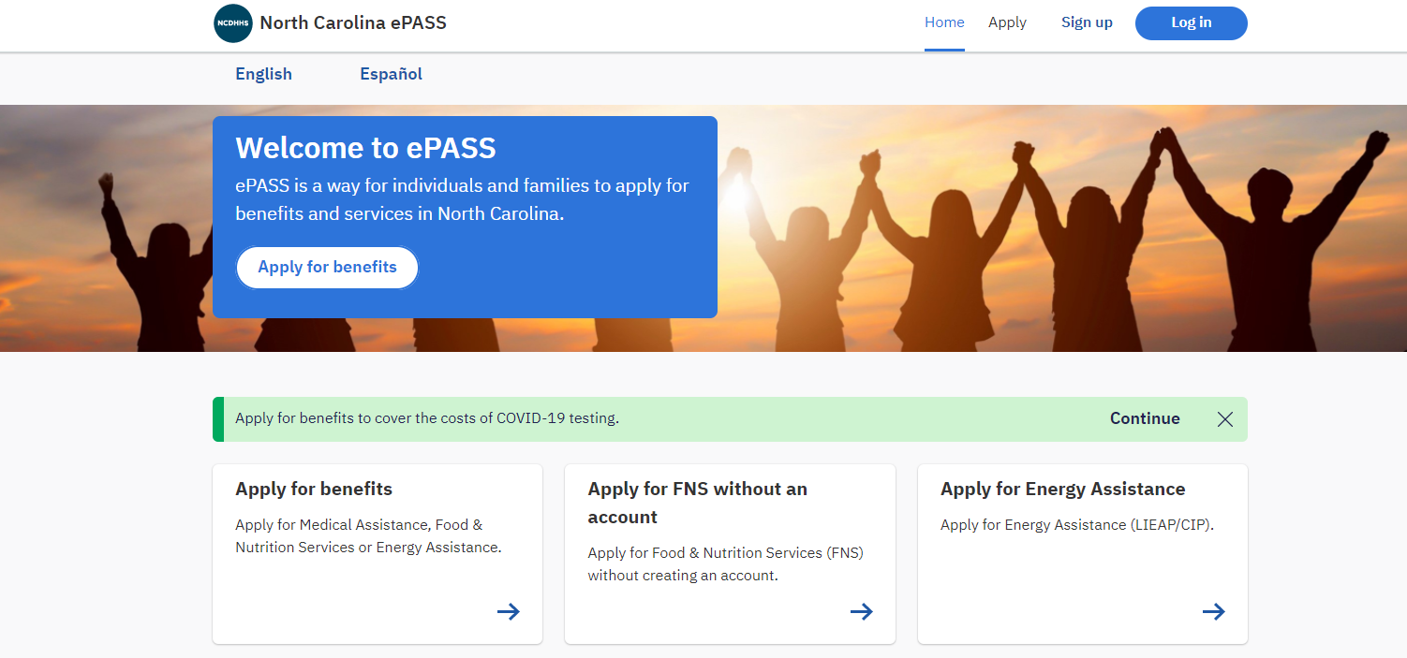
ONLINE – EPASS
https://epass.nc.gov/

Slide 13
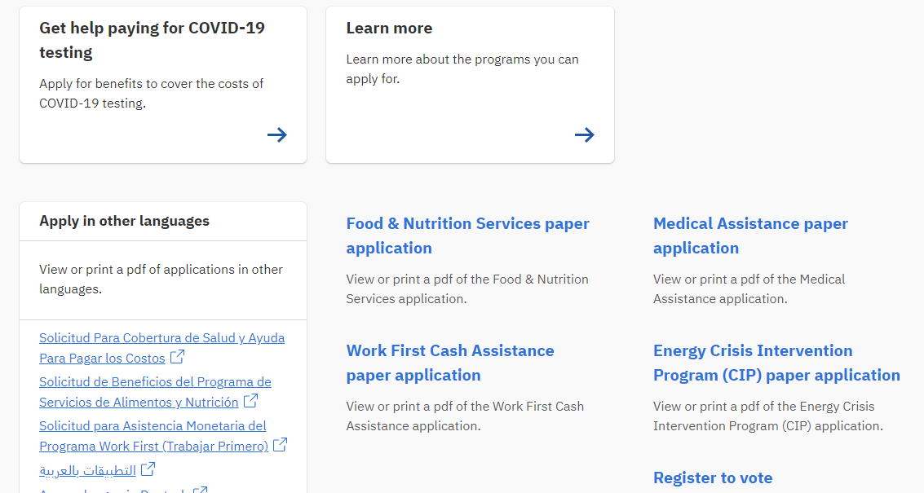
ONLINE – EPASS
https://epass.nc.gov/

Slide 14
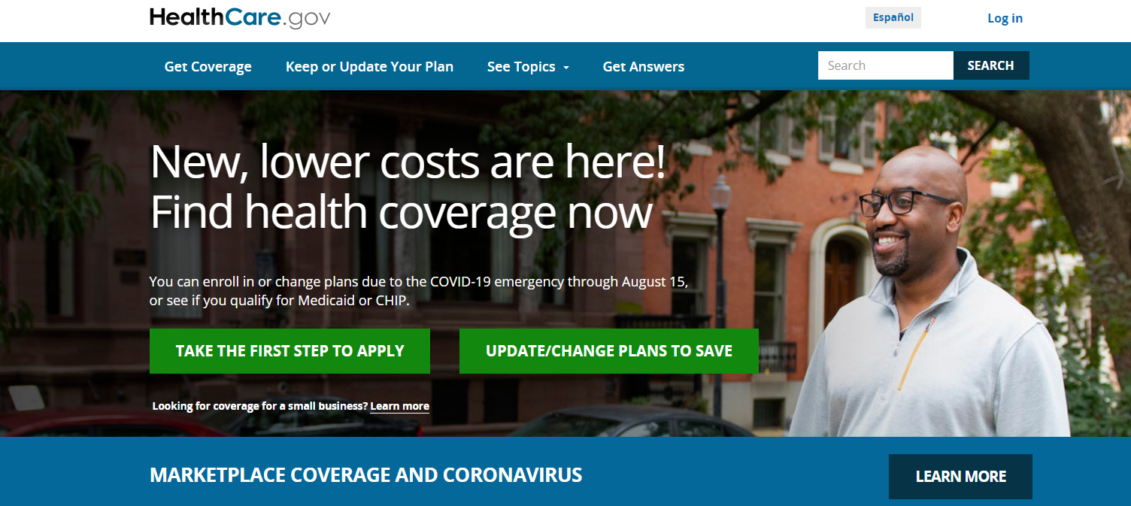
ONLINE – HEALTHCARE.GOV
Healthcare.gov, also known as the “Marketplace” or “exchange” is a secure web-based self-service tool that allows individuals to shop for and/or enroll in affordable health insurance.
https://www.healthcare.gov/

Slide 15
ONLINE – HEALTHCARE.GOV
1. The individual will be screened for North Carolina Medicaid and NC Health Choice.
2. If the individual is potentially eligible for Medicaid/NCHC (based on the information provided), their account will be transferred to the appropriate local agency.
3. Application date is the date the application is received at the Marketplace.
Healthcare.gov

Slide 16
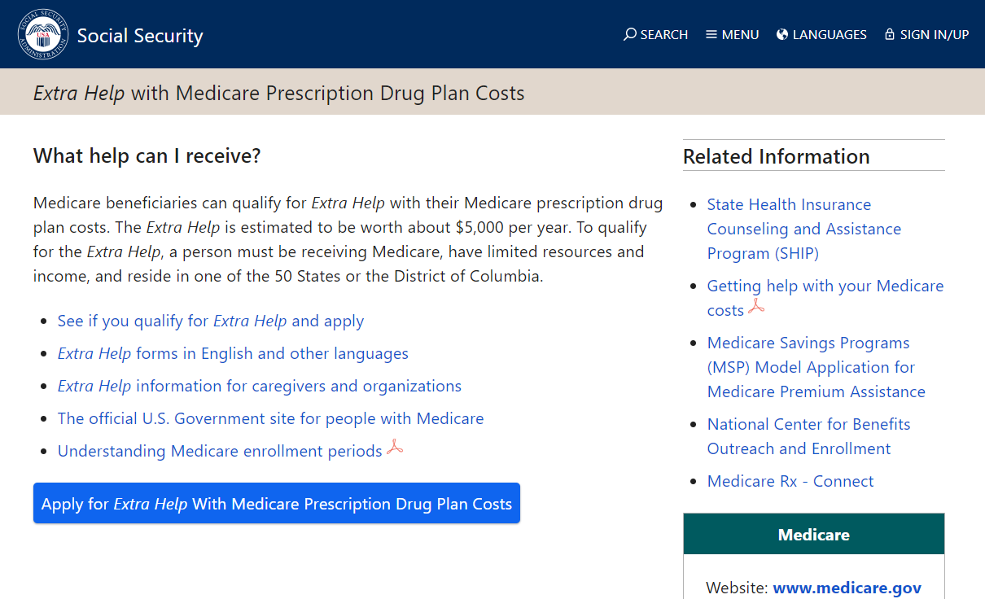
ONLINE – LOW INCOME SUBSIDY (LIS)
Low Income Subsidy (LIS) applications are submitted electronically to DSS from Social Security Administration.

Slide 17
ONLINE – LOW INCOME SUBSIDY (LIS)
Low Income Subsidy (LIS) applications are submitted electronically to DSS from Social Security Administration.
DMA matches the data with current Medicaid recipient data and creates an electronic North Carolina Medicaid application for individuals who are not current Medicaid/MQB recipients or do not have a pending application.
If an individual indicates that he does not want to transmit the data to the state by answering “no” to question 15 on the initial LIS Application, no application will be created.
https://www.ssa.gov/benefits/medicare/prescriptionhelp/

Slide 18
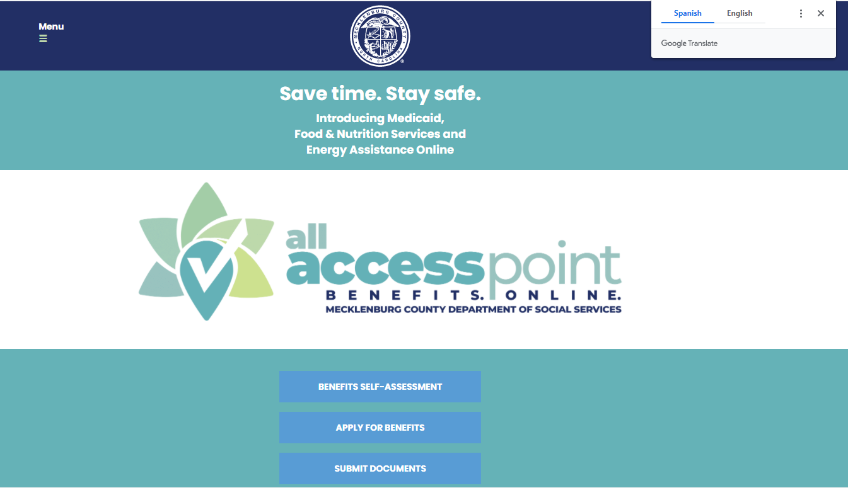
ONLINE – DSS ALL ACCESS
DSS All Access allows customers to apply for Food and Nutrition Services, Medicaid, and energy assistance benefits from a single online location in English or Spanish or other languages.
https://allaccess.mecknc.gov/

Slide 19
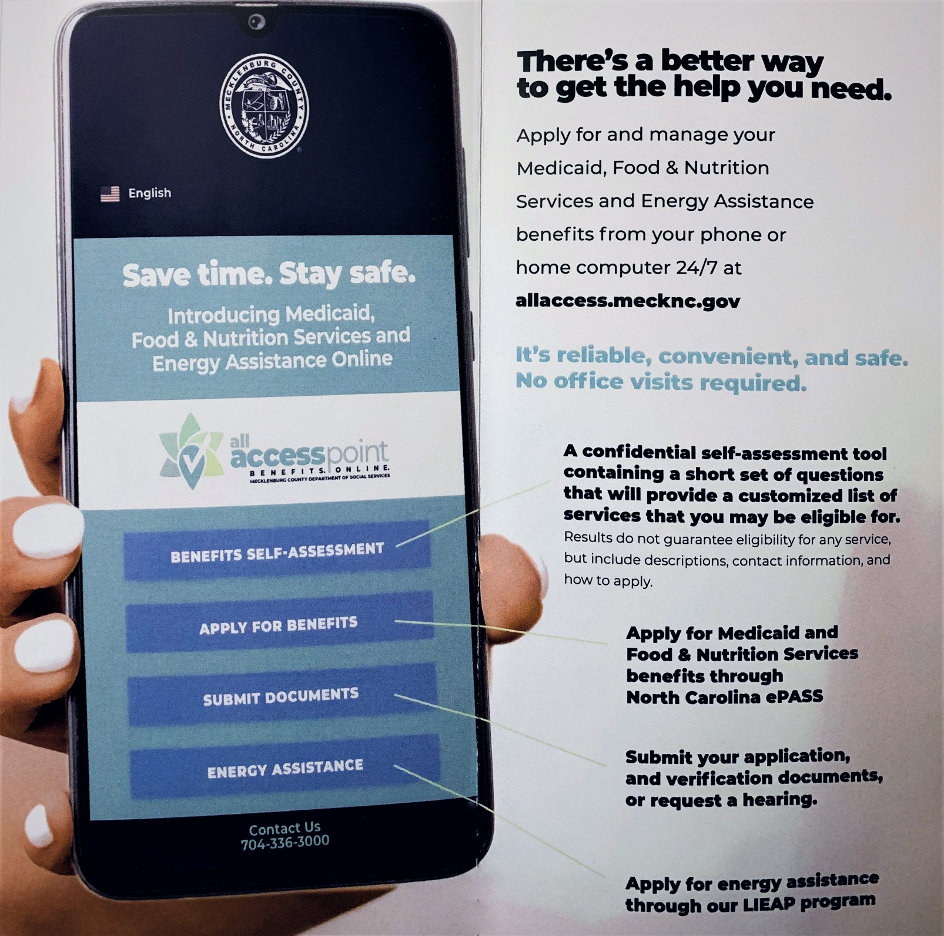
ONLINE –
DSS ALL ACCESS
The app is user-friendly and can be accessed on any mobile or desktop device.
Customers can add the web app to their home screen by following the instructions listed on the menu at the top left corner of the webpage.

Slide 20
BASIC ELIGIBILITY FACTORS
FOR THE AGED, BLIND, AND DISABLED

Slide 21
Basic factors of Eligibility for The Aged, blind, and Disabled
Be a US Citizen or Qualified Alien
  Note: Non-Qualified Aliens are potentially eligible for Emergency Services Only
  Have a social security number or apply for one
  Note: Some Qualified Aliens are not eligible for an SSN
Be a resident of North Carolina.
Meet the Income Requirements
Meet the Reserve Requirement
Apply for all benefits to which he may be entitled
Meet the Age/Blind/ Disable Requirements

Slide 22
Basic factors of Eligibility for The Aged, blind, and Disabled
If a disability determination is needed, the disability assessment will be complete and submitted to Disability Determination Services.
The assessment is a part of the Medicaid application for applicants who do not have a disability determination.
The assessment sent to DDS by the local DSS agency includes:
DMA-4037 Disability Determination Transmittal
DHB-5009 Social History Summary
DHB-5028 Authorization to Disclose Information

Slide 23
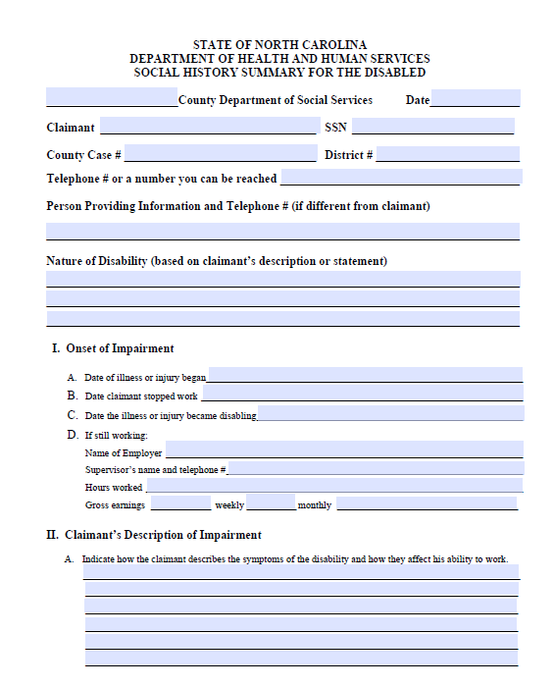
DHB-5009
Medicaid is a program to assist eligible aged, disabled, blind individuals with the cost of medical care. Potentially eligible customers range from disabled or blind children to adults.
DMA-5009 Social History Summary for
the Disabled
https://policies.ncdhhs.gov/departmental/forms
The hard copy of the DHB-5009 is not needed if the applicant or representative is reached to complete by phone.

Slide 24
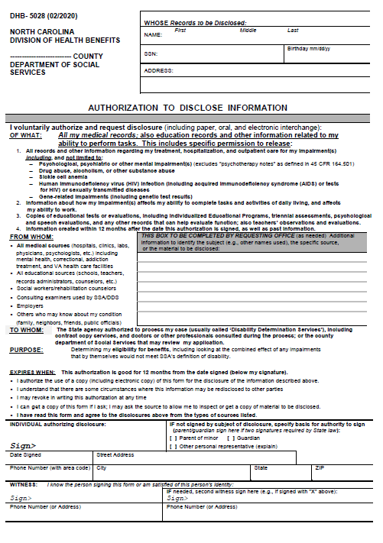
DHB-5028
Medicaid is a program to assist eligible aged, disabled, blind individuals with the cost of medical care. Potentially eligible customers range from disabled or blind children to adults.
DHB-5028 Authorization to Disclose Information
https://policies.ncdhhs.gov/departmental/forms
A complete DHB-5028 will need to be signed and dated by the claimant and include both front and back pages.

Slide 25
MEDICAID PROGRAMS FOR THE AGED, BLIND, AND DISABLED

Slide 26
Medical Assistance for the Disabled
(M-AD)
Program for persons under 65 yrs. of age who meet the Social Security definition of disability. They must be found disabled by the Disability Determination Services in Raleigh if they have not already been determined by the Social Security Administration. These applications must be processed within 90 days.
MAABD - Programs

Slide 27
Medical Assistance for the Blind
(M-AB)
This program is for those persons under 65 years of age who meet disability due to blindness. The Division of Services for the Blind makes this determination, if it has not been already determined.
MAABD - Programs

Slide 28
Medical Assistance for the Aged
(M-AA)
This program is for those persons 65 years of age and older. They do not have to be found disabled by the Disability Determination Services in Raleigh or the Social Security Administration.
MAABD - Programs

Slide 29
Healthcare for the Working Disabled (HCWD)
HCWD covers blind or disabled workers age 16 - 64 regardless of total countable income or CAP status. However, there is a limit on unearned income of 150% of the federal poverty level.
They must be found disabled by the Disability Determination Services in Raleigh if they have not already been determined by the Social Security Administration. These applications must be processed within 90 days.
MAABD - Programs

Slide 30
Medicare Qualified Beneficiary (MQB)
Other programs that can be received in Adult Medicaid are the Medicare Qualified Beneficiary, MQB programs, or what is normally called “Limited Medicaid”. Recipients must have Medicare Part A and / or B in order to qualify.

Slide 31
We have discussed applications; we have discussed programs but must admit that we do sometimes face obstacles.

Slide 32
One of the main obstacles when assisting adults who are homeless or at risk of homelessness to apply for benefits is…

Slide 33

Lost contact during the application process.
What are the results?
There are missing verifications needed to determine eligibility.
The application will be denied for failure to provide required verifications.
The approval rates are reduced for individuals who would likely meet the eligibility requirements.

Slide 34

WHAT CAN WE DO TO HELP?

Slide 35
WHAT CAN WE DO TO HELP?
When contact is made with the applicant, discuss designating an authorized representative.
Verify both the mailing and physical address
Verify valid phone number(s) and email address if applicable
Get as much required information as possible upon initial contact

Slide 36
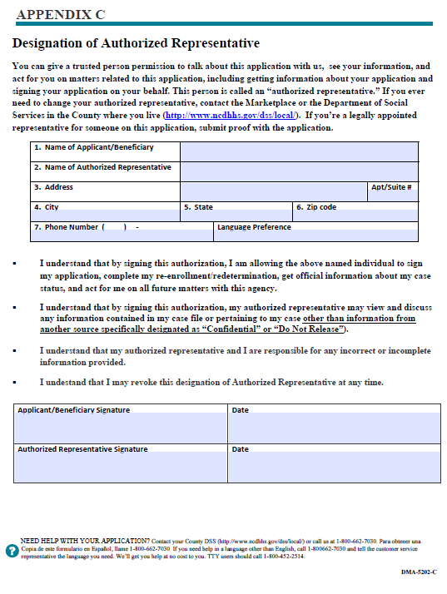
DMA-5202-C
Medicaid is a program to assist eligible aged, disabled, blind individuals with the cost of medical care. Potentially eligible customers range from disabled or blind children to adults.
The DMA-5202-C, Designation of
Authorized Representative
https://policies.ncdhhs.gov/departmental/forms
An applicant can have more than one representative.
An applicant may revoke designation of Authorized Representative at any time.

Slide 37
APPLICANTS RIGHT TO AN APPEAL

Slide 38
REQUEST FOR APPEAL
An applicant has the right to appeal an action if they disagree with the local agency decision.
  The applicant may request the hearing verbally or in writing.
  The applicant must request a hearing within 60 calendar days from the date the notice of action is mailed or given, unless they can show good cause for a later request.
  If good cause exists, the request must be no later than 90 calendar days from the date of the notice of action.

Slide 39

This concludes our training session
Any Questions from the audience?

Slide 40
LINKS AND CONTACTS
https://policies.ncdhhs.gov/departmental/forms
https://epass.nc.gov/
https://www.healthcare.gov/
https://allaccess.mecknc.gov/
https://www.ssa.gov/benefits/medicare/prescriptionhelp/
Kuralt Centre - 301 Billingsley Road, Charlotte, NC 28211
Community Resource Center (CRC) - 3205 Freedom Drive, Suite 1000, Charlotte, NC 28208
Mecklenburg County Department of Social Services
Customer Connection: 704-336-3000

