Slide 1


Slide 2

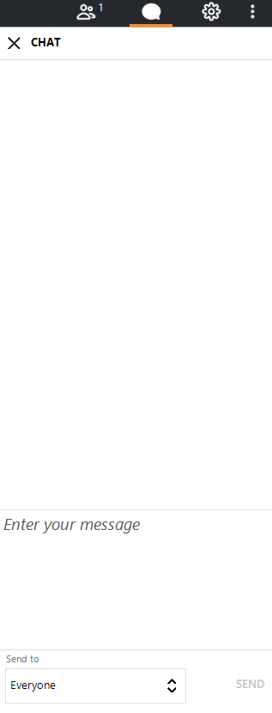
Roll Call
This call will be recorded and provided for later review.
Welcome!
As we gather, please use the chat box to tell us you’re here and what agency you’re with.
After you’ve done that, take time to take a few deep breaths and give yourself some quiet space to center and be present before we begin.
If you’re able to share your camera, we’d love to see your faces! It helps us avoid feeling like we’re speaking to a empty box.
The chat box is available to use anytime during the call for questions or suggestions.
Please keep your line muted when you’re not speaking and unmute as needed.

Slide 3
Welcome
Back@Home System + Logistics Call

Slide 4
Agenda September 9, 2021
Back@Home Progress Report
Assessment + Referral System
Program Guidance Updates/Reminders
Questions/Discussion

Slide 5
Housing Stabilization Status
Back@Home Progress Report

Slide 6
+ 103 Households Stabilized in Housing
 | Households | Adults | Children | People
Total Stabilized | 550 | 662 | 482 | 1144
Total Moved In | 520
Total Stabilized in Place | 29
This Week
as of 9.9.21
as of 8.12.21
 | Households | Adults | Children | People
Total Stabilized | 447 | 540 | 388 | 928

Slide 7
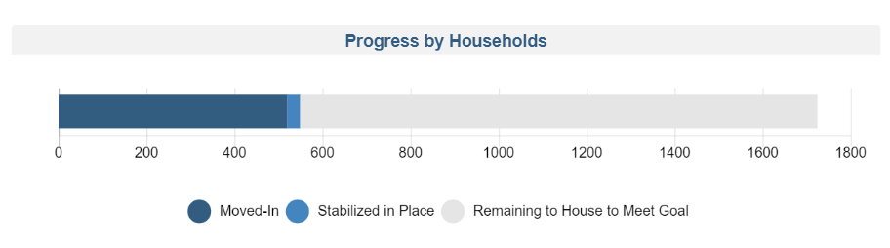

Slide 8
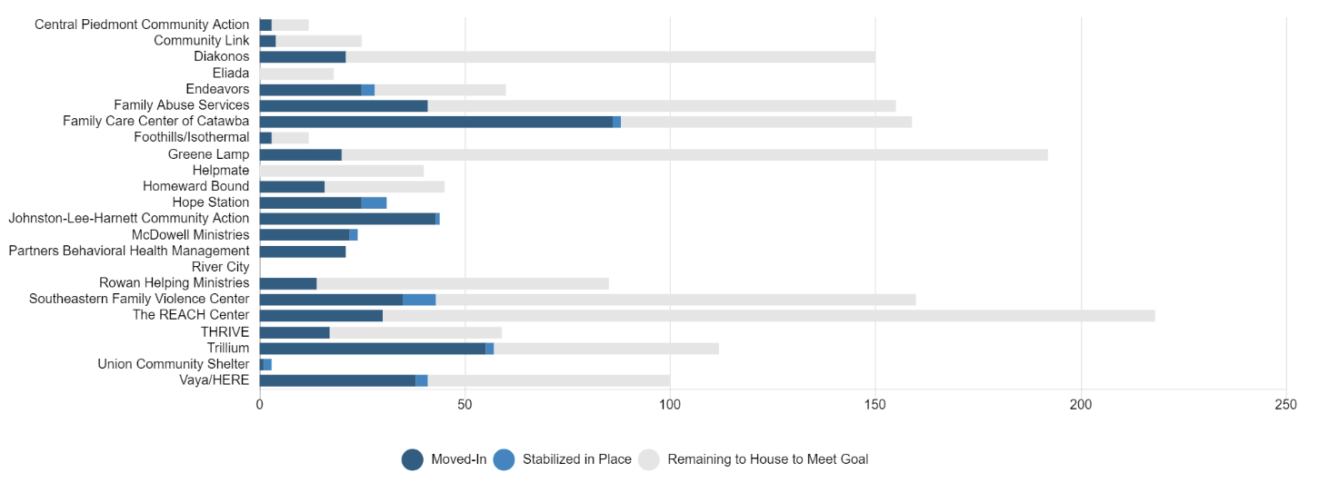

Slide 9
Live Dashboard
View Back@Home Progress anytime via the smartsheet dashboard.
NEW LINK!
https://app.smartsheet.com/dashboards/CF2CqhqwwGHJvQ8fJMJrPF7q8VCfprVGxmg4vF61
Data refreshes 1x/hour
Public Link (anyone can see it when you share the link)

Slide 10
Assessment + Referral System

Slide 11
Counties currently paused for 211 referrals
  Beaufort
  Bertie
  Buncombe
  Cabarrus
  Camden
  Carteret
  Chowan
  Cleveland
  Craven
  Cumberland
  Currituck
  Dare
  Davidson
  Gaston
  Gates
  Hertford
  Hyde
  Jones
  Lincoln
  Martin
  Nash
  Northampton
  Onslow
  Pamlico
  Pasquotank
  Perquimans
  Pitt
  Stanly
  Tyrrell
  Washington

Slide 12
Program Wide Pause
All counties will be paused for 211 referrals starting Monday 9/13
Will review data and Rehousing Agency input each Friday to decide 211 county status for the next week
During pause:
  Work with clients on list
  Keep smartsheet client list data updated
  211 Callers will be referred to other resources in 211 database, including CE
  CE referrals to Back@Home open– CE should first inquire about Rehousing Agency capacity to serve (or open daily slots)

Slide 14
Referrals Moving Forward
Every Friday Morning:
Back@Home Leadership will decide which counties to pause or reopen
  Only Rehousing Agencies with a grey bar to the right will be reopened
  Rehousing Agencies may request to pause at any time
  Projections can be adjusted

Slide 15
List Management
Make sure you’re keeping these fields up to date to keep dashboard data accurate!
EN-1 Enrollment Status
EN-4 Prior Living Situation
RA-2 Housing Stabilization Status
RA-3 Move-In Date

Slide 16
Tools for List Management
View Not Started for over 14 days
https://app.smartsheet.com/reports/CrXcJrphv2mqGMQqcr4VWHWCJJVJCh7vfw82h8X1
View All Not Started and Started by Status
  https://app.smartsheet.com/reports/RCJR6M47rwhfjxp5cP5V978gcHX2PmXMrCHm8471

Slide 17
Referrals from CE
Use the option to refer from CE!
Tell your CE Lead to reach out to backathome@ncceh.org if they don’t remember how!
If 211 is paused, community can decide to use B@H assessment through CE as needed.

Slide 18
Program Guidance

Slide 19
ESG-CV
Spending Plans
Reviewing Your Budget
Potential Need to Reallocating or Return Funds

Slide 20
Unit Support
Utilities need to be turned on for HQS Inspections
Ensure you’re coordinating with landlords and inspectors

Slide 21
Questions? Discussion?

