Slide 1
Clinical & Community Data Initiative (CODI) - North Carolina

Slide 2

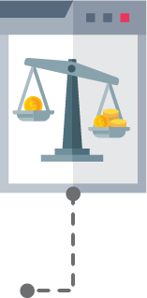
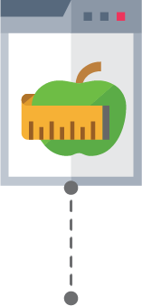
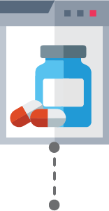


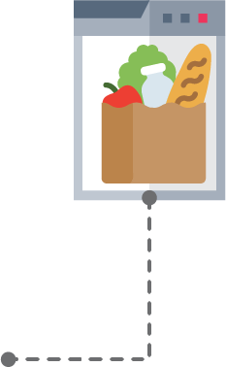

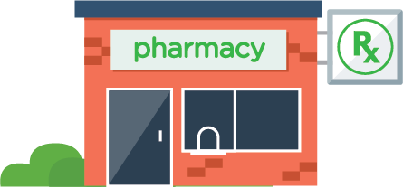
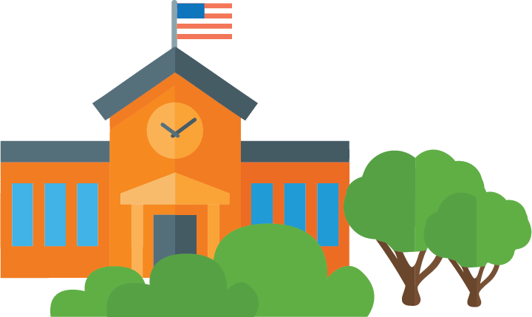
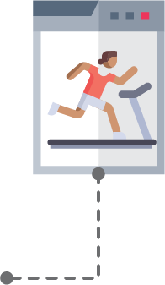

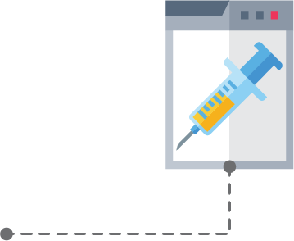



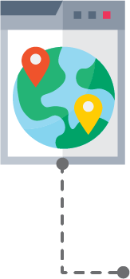
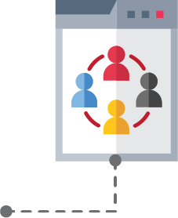




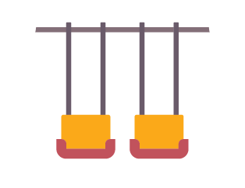




Why do we need CODI?
Important information about our health can be found in places throughout the community – not just at a doctor’s office.
This information may include participation in physical activity programs, use of community support services such as a food bank, education, clinical data, social determinants of health (SDOH), and so much more.
Putting the pieces of this information puzzle together can help us better understand the full picture of the diverse factors that affect our health.

Slide 3


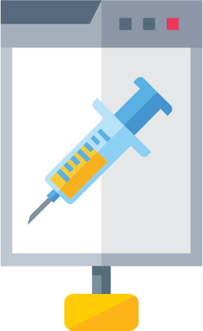
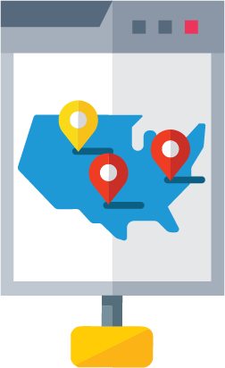
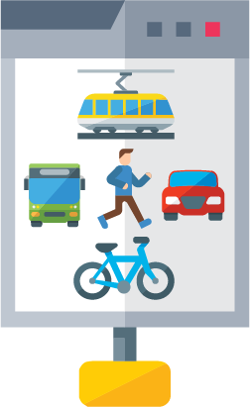


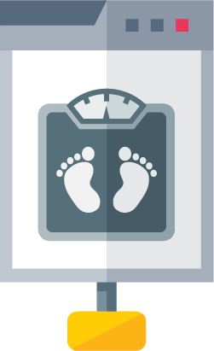

What does CODI do?
CODI aims to build an infrastructure in the NC Triangle region that can be used to link an individual’s data throughout the community into a single record that can be used to help us answer questions related to health, community programs, local policies, and other topics of interest to local collaborators.

Slide 4


How are CODI data used?
Researchers: Enables comparative effectiveness studies
Community Partners: Provides data on health improvements associated with interventions
Policy Makers: Increases understanding of community chronic disease prevalence
Clinical Partners: Increases awareness of community-based program for patient referral

Slide 5





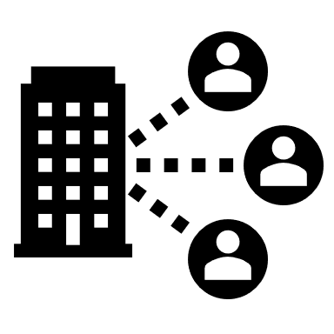
What are the potential benefits of participating in CODI?
Enhance evaluation and continuous improvement
Demonstrate leadership
Cultivate partnerships
Understand health inequities
Identify evidence-based practices
Attract funding

Slide 6
Who is involved?
CODI@NC will include multiple collaborators from clinical and community-based organizations. The project is sponsored by the US Centers for Disease Control and Prevention (CDC).
The Project Management Team
Centers for Disease Control and Prevention | Public Health Informatics Institute
The MITRE Corporation | National Association for Community Health Centers
Potential Partners in North Carolina Triangle Region
Duke University | Special Supplemental Nutrition Program for Women, Infants and Children
University of North Carolina Chapel Hill | Local Health Departments – Durham County
Parks & Recreation – Durham, Chapel Hill | NC Coalition to End Homelessness
YMCA of the Triangle

Slide 7
Ensuring Data Privacy and Protection

Slide 8




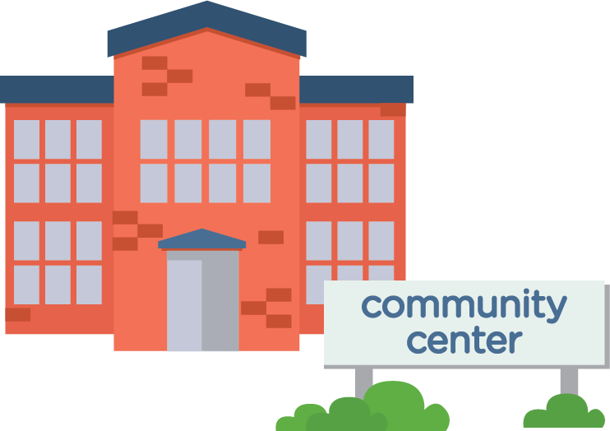
How does CODI work?
1
Program Evaluation, Surveillance,
and Research
2
3
Query
Data
Coordinating
Center
Local
Queries
TTP
Longitudinal
Records
4
5
CODI functions as a Distributed Data Network. This means that each organization’s data stays secure behind their firewall. When someone asks a question about this data, a query is sent to each participating organization, a subset of the relevant, de-identified data is pulled from each database, and finally assembled into a single record.

Slide 9








How does CODI work?
Personally Identifiable
Information (PII)
Personally Identifiable
Information (PII)
Data
Hashing
Data
Hashing
In order to ensure that an individual’s identity is protected, the CODI project uses a process called Privacy Preserving Record Linkage (PPRL). PPRL creates “garbled” identifiers for individuals that are used to link their data across the community into a single, longitudinal record.

Slide 10
What steps does CODI take to protect & ensure privacy of your data?
CODI creates a technology and partnership network that allows partners to maintain control over their own data
The queries are designed to extract on the minimum required data, without PII
The Privacy Preserving Record Linkage process is designed to use “garbled” identifiers to link data that protect individual identities
Before data is shared, CODI implementing partners will establish governance to build trust and reconcile regulations, policies, and norms needed for data exchange. For CODI, governance includes policies, processes, and agreements to assure Data Owners that data sharing is ethical, transparent, and compliant with appropriate laws and regulations
TTP

Slide 11
Implementation Timeline
 | 2022 |  |  |  |  |  |  |  |  |  |  |  | 2023
 | Jan | Feb | Mar | Apr | May | Jun | July | Aug | Sep | Oct | Nov | Dec | Jan | Feb | Mar
Information Gathering
Governance
Development
Implementation
Revise & Validate Scoping Questions
Scope
Develop Use Cases
Use Cases
Develop Governance Strategy & Execute Agreements
Governance
Refine Data Model
Tools
Implement CODI Data Model
Test PPRL
QC PPRL
Implement PPRL
Develop Use Case
Query code
Construct Longitudinal Dataset for Use Case

Slide 12
Expectations for Partner Participation

Slide 13
What are we asking partners to do?
Engagement
Technical Implementation
Attend meetings and provide input on strategy, governance, and the questions you want answered with the data
Use the CODI tools to map your data to create the linked dataset w/ other organizations

Slide 14
Are there resources available to support your participation in CODI?
YES!
TTP
The following slides provide more information on estimated hours for CODI participation to help start the contracting process for financial support.

Slide 15
Will your organization’s participants need to provide consent about the use of their data in CODI?
This depends on your organization’s current policies. Below are some approaches our partners in the CODI Denver pilot exercised:
  One of the organizations felt that it was part of their treatment/payment/operations and there was no need to provide a disclaimer
  One organization sent a letter to participants to let them know that they would be sharing deidentified information, and offer them the opportunity to opt out; but none of the participants chose to
One of our current partner organizations currently has a disclaimer in their registration language that indicates that deidentified information may be used, and many organizations have similar language; you may already have such language in your registration materials
TTP

Slide 16

CODI Denver Partner Experience
"We were initially intrigued when we were approached to participate in CODI, but we didn’t quite know where it would lead. Since we joined the project, we’ve received some preliminary insights from our data. We’ve strengthened connections to clinical partners in our state. And the CODI team has made participating with the technology turnkey, supporting and guiding us throughout the process. We look forward to continuing to participate as the project continues to evolve here in Colorado."
Lisa Johnson, Executive Director
Girls on the Run of the Rockies

Slide 17

Thank you!
Please email CODI@cdc.gov with questions.

Slide 18
Why do we need CODI?
CODI brings together brings together local people (local individuals, organizations, collaboration), processes (data assessments, sharing, and governance) and technology (record linkage, data models, analytic programs) in order to create a local infrastructure to support community efforts to achieve data-driven approaches to achieving health equity

