Slide 1
Racial Equity Subcommittee Meeting
NC Balance of State CoC
March 16, 2022 at 11:30 AM
The purpose of the Racial Equity subcommittee is to identify areas in NC Balance of State CoC’s policies that may contribute to racial disparities in access to and services from the homeless system and to recommend changes to them.

Slide 2
Logistics
Notes:
Laurel

Slide 3
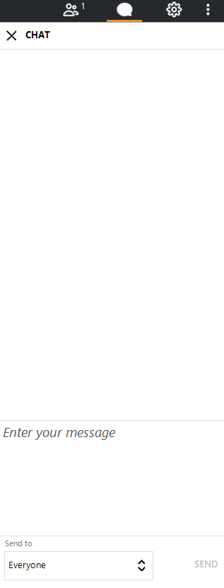
Welcome
Your line is not muted.
Please mute yourself.
The chat box is available to use anytime.
Notes:
Everyone is currently on mute. We encourage your questions though.
We want to encourage the use of the chat box. We will monitor the chat box for activity and make sure we respond to your questions.

Slide 4

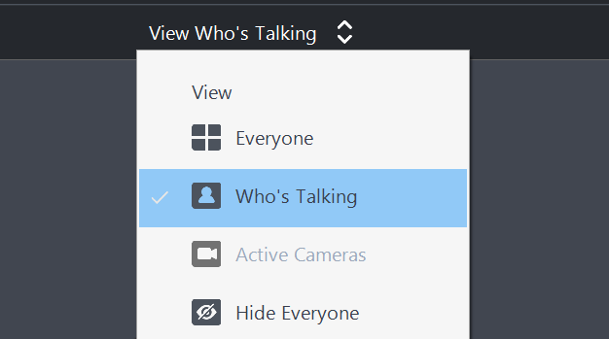
Camera
To foster connection, we encourage every member to turn on their camera. The camera graphic is at the bottom of your screen.
We have a lot of people! It may be easier to set the cameras to only show who is currently speaking. You can access this setting at the top of the screen.

Slide 5
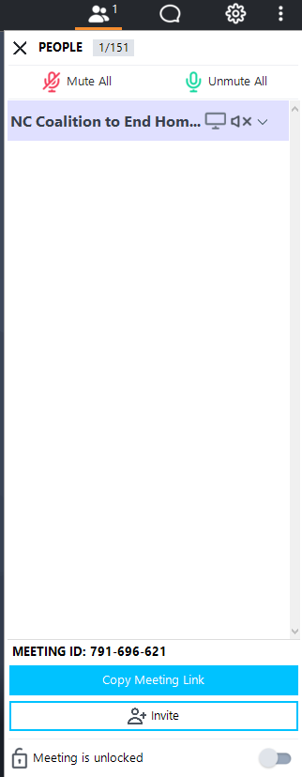
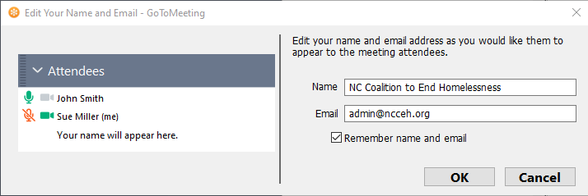
Attendance
1
Participants should right click on the caller marked as ‘me’ and fill in their full name and email address.
Please enable your webcam (if possible). Let's get to know each other as much as possible!
2
Notes:
Please be sure to enter your full name and email address in the tool bar, if your name is not already there. We will use the email addresses collected here to send information out about the CoC competition.
* Roll Call*

Slide 6
Agenda

Slide 7
Agenda
Celebrations
2022 Goals!
Announcements
Share your successes in the chat box!
Introductions
Updates
Notes:
Change as needed

Slide 8

Celebrations and Announcements
Notes:
Sarah

Slide 9

Goals for 2022
Notes:
Goal Setting:
Introduce the tool Jamboard, (stickies, panels, then Identify what rises to the top, main subcommittee vs workgroup)
- RE Assessment
- Equity Initiative to improve CE
- Dialogues
- Scorecard (Eval & Dev)
All one color b/c from last year
- green sticky anti-discrimination possibility
Invite more Stickies for ideas
- give 5 min?
Breakout into smartsheet categories for r
- Governance
- Data
- Education

Slide 10
Goals for 2022 ideas
Topics:
Education
Governance
Improving the CoC
Legislative Advocacy
Understanding the CoC
Questions
Is this a subcommittee goal for 2022?
Is this a workgroup? Who’s interested?

Slide 11
Education
Racial Equity Dialogues
Workgroup planning three for 2022
  Obstacles to Homebuying (April 12)
  Impacts of Stress/Trauma (June 21)
  Housing Solutions for the Future (October 18)
Landlord Education on Fair Housing
Equity Training for shelters/providers
Landlord/Tenant Dialogue on accountability

Slide 12
Governance
Anti-Discrimination Policy
Used for mandatory annual training
Used for funding scoring
Scorecard Evaluation & Revision
Used for scoring grant applications for CoC funding (RRH, PSH)
Introduced last year
Was a difference maker for ranking and selecting which programs were funded.
Immediate opportunity to provide edits and improve these questions for upcoming CoC competition and potentially ESG competition (ES, SO, RRH, HMIS).

Slide 13
Improve the CoC
Equity Initiative with HUD TA
Year long technical assistance cohort
Recruiting Core Team members to create more equitable Coordinated Entry prioritization tool
Includes Core Team workgroup meetings 2-3 times a month and Knowledge Bite trainings 2 times a month

Slide 14
Legislative Advocacy
Objectives
  Obtaining affordable housing in the NC BoS CoC
    State and local levels
  Addressing “Not In My Backyard” mentality when talking about affordable housing.
  Fair Housing enforcement
    Focus on property owners to maintain safe housing units

Slide 15
Understanding the CoC
Annual Racial Equity Assessment
Analyzes CoC data to find disparities and propose solutions
Submitted in CoC funding competition
Completed by Data Center with Subcommittee review/direction every year since 2019
Subcommittee recommended deeper analysis year over year for 2022 Assessment

Slide 16
Agenda items for next meeting?
What needs to be discussed?

Slide 17
Wrap Up
Next Meeting:
Keep in touch
bos@ncceh.org
919.755.4393
April 20th
11:30 A.M.

