Slide 1
Racial Equity Subcommittee Meeting
NC Balance of State CoC
April 20, 2022 at 11:30 AM
The purpose of the Racial Equity subcommittee is to identify areas in NC Balance of State CoC’s policies that may contribute to racial disparities in access to and services from the homeless system and to recommend changes to them.

Slide 2
Logistics
Notes:
Laurel

Slide 3
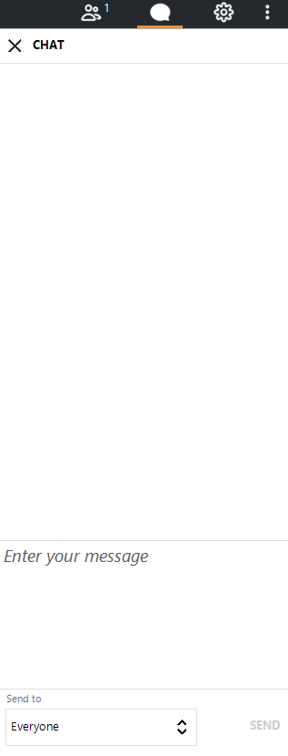
Welcome
Your line is not muted.
Please mute yourself.
The chat box is available to use anytime.
Notes:
Everyone is currently on mute. We encourage your questions though.
We want to encourage the use of the chat box. We will monitor the chat box for activity and make sure we respond to your questions.

Slide 4

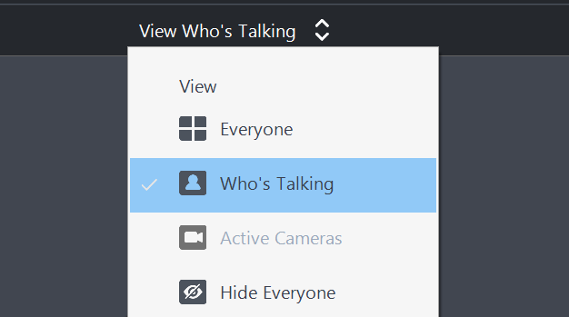
Camera
To foster connection, we encourage every member to turn on their camera. The camera graphic is at the bottom of your screen.
We have a lot of people! It may be easier to set the cameras to only show who is currently speaking. You can access this setting at the top of the screen.

Slide 5
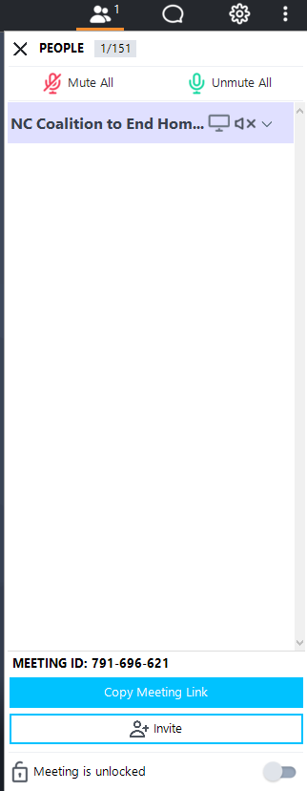
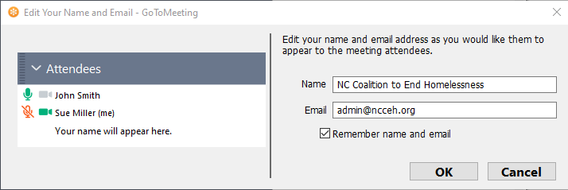
Attendance
1
Participants should right click on the caller marked as ‘me’ and fill in their full name and email address.
Please enable your webcam (if possible). Let's get to know each other as much as possible!
2
Notes:
Please be sure to enter your full name and email address in the tool bar, if your name is not already there. We will use the email addresses collected here to send information out about the CoC competition.
* Roll Call*

Slide 6
Agenda

Slide 7
Agenda
Celebrations
CoC Scorecard Edits
Equity Initiative Update
Share your successes in the chat box!
Introductions
Racial Equity Dialogue Debrief
Notes:
Change as needed

Slide 8

Celebrations and Announcements
Notes:
Sarah

Slide 9
Introductions
What is one hidden gem in your part of NC?

Slide 10

Racial Equity Dialogue
Debrief
Notes:
Sarah

Slide 11
RE Dialogue Debrief
Took place Tuesday 4/12
Topic: Barriers to Homeownership for People of Color Experiencing Homelessness
Over 80 attendees
What is your feedback?

Slide 12

Overview of CoC Competition and Scorecard
Notes:
Sarah

Slide 13
CoC Competition Overview

Slide 14
Types of CoC applications
New projects
Renewal projects
  About 25 projects will apply to renew
Components:
  Permanent housing
    19 PSH projects in the CoC
  Rapid re-housing
    4 RRH projects in the CoC
  Infrastructure (not scored)
    1 SSO-CE project
    1 HMIS project

Slide 15
CoC Competition Review and Ranking
CoCs must rank and tier projects based on:
  Performance
  HUD and CoC priorities
Scorecards help us rank projects and set priorities for ranking.

Slide 16
Rank & Tier
The Project Review Committee and NCCEH staff review each project using the CoC’s scorecards
The PRC then ranks the projects in order of performance and priority
HUD requires CoCs to split our eligible funds into two tiers

Slide 17
NC BoS CoC Scorecard Overview

Slide 18
Scorecard has 4 goals
Fund organizations that have the capacity to run effective programs
Fund projects that reflect the NC Balance of State Continuum of Care’s & HUD’s priorities
Incentivize agencies to be good partners
Ensure that funded projects are being good stewards of NC BoS CoC funding and performing to CoC standards

Slide 19
Two scorecards
New
  Greater focus on agency capacity and experience
Renewal
  Greater focus on grant performance
Both New and Renewal
  Same basic standards of program design

Slide 20
Project Ranking was informed by the CoC’s Funding Priorities and the scorecard.
NC BoS CoC Funding Priorities
  Guidance from the Continuum of Care on its priorities for funding. This includes priorities for funding specific project types and regional need.
Scorecard
  Thresholds: If projects do not meet them, they cannot move forward in the competition.
  Standards: Important aspects that projects are expected to meet. Project standards should be evaluated to determine where ranked or if project is funded.
  Section Score Minimums: Ensure every project meets a basic level of performance in every section of the scorecard.
  Total Score: Helps determine the order of ranking after considering thresholds and standards.

Slide 21
Some questions on both new and renewal scorecards are standards.
Standard options are: met, unmet, unmet-documentation not provided, NA
Don’t want to award points for something that projects should be doing
Project Review Committee has used standards as part of the ranking process in the past and uses precedent
  Housing First
  PSH Key Elements
  RRH Performance Benchmarks and Program Standards

Slide 22
Points and performance
Using data to measure performance is increasingly important.
Projects are scored on data including:
  Targeting: serving people with disabilities, chronically homeless, etc.
  Positive exits
  Increases in income
Points will pull the highest performing programs to the top

Slide 23
The 2021 CoC Scorecard introduced an Equity Section
New questions to the CoC scorecard are primarily structured as points to reward agencies that are aligned with the CoC’s priorities and to signal those priorities that may need to make changes to be in full alignment.
The intention is to assign greater weight to these questions over time to drive compliance forward.
Proposed edits to the 2021 scorecard increase one question from points to a standard, increase the points value of one question, and introduce two new questions.

Slide 24
The Racial Equity Subcommittee can approve this draft
An approved draft will be submitted to the Scorecard Committee for further revision and inclusion in the final CoC Scorecard.
Questions?
Motion?

Slide 25

Equity Initiative
Notes:
Goal Setting:
Introduce the tool Jamboard, (stickies, panels, then Identify what rises to the top, main subcommittee vs workgroup)
- RE Assessment
- Equity Initiative to improve CE
- Dialogues
- Scorecard (Eval & Dev)
All one color b/c from last year
- green sticky anti-discrimination possibility
Invite more Stickies for ideas
- give 5 min?
Breakout into smartsheet categories for r
- Governance
- Data
- Education

Slide 26

Equity Initiative Core Team
WHEN
Through December
About to 2-3 hrs/wk
Meeting time can be flexible
WHERE
Virtual meetings on Zoom or Microsoft Teams
You'll need access to a smart phone or computer and the internet.
We may be able to help!

Slide 27
2022 Goals

Slide 28
Goals for 2022 ideas
Topics:
Education
Governance
Improving the CoC
Legislative Advocacy
Understanding the CoC
Questions
Is this a subcommittee goal for 2022?
Is this a workgroup? Who’s interested?

Slide 29
Education
Racial Equity Dialogues
Workgroup planning three for 2022
  Obstacles to Homebuying (April 12)
  Impacts of Stress/Trauma (June 21)
  Housing Solutions for the Future (October 18)
Landlord Education on Fair Housing
Equity Training for shelters/providers
Landlord/Tenant Dialogue on accountability

Slide 30
Governance
Anti-Discrimination Policy
Used for mandatory annual training
Used for funding scoring
Scorecard Evaluation & Revision
Used for scoring grant applications for CoC funding (RRH, PSH)
Introduced last year
Was a difference maker for ranking and selecting which programs were funded.
Immediate opportunity to provide edits and improve these questions for upcoming CoC competition and potentially ESG competition (ES, SO, RRH, HMIS).

Slide 31
Improve the CoC
Equity Initiative with HUD TA
Year long technical assistance cohort
Recruiting Core Team members to create more equitable Coordinated Entry prioritization tool
Includes Core Team workgroup meetings 2-3 times a month and Knowledge Bite trainings 2 times a month

Slide 32
Legislative Advocacy
Objectives
  Obtaining affordable housing in the NC BoS CoC
    State and local levels
  Addressing “Not In My Backyard” mentality when talking about affordable housing.
  Fair Housing enforcement
    Focus on property owners to maintain safe housing units

Slide 33
Understanding the CoC
Annual Racial Equity Assessment
Analyzes CoC data to find disparities and propose solutions
Submitted in CoC funding competition
Completed by Data Center with Subcommittee review/direction every year since 2019
Subcommittee recommended deeper analysis year over year for 2022 Assessment

Slide 34
Agenda items for next meeting?
What needs to be discussed?

Slide 35
Wrap Up
Next Meeting:
Keep in touch
bos@ncceh.org
919.755.4393
May 18
11:30 A.M.

