Slide 1
Using HMIS to Evaluate Program Outcomes
NCCEH Data Center

Slide 2
Agenda
Why evaluate your programs?
Evaluation questions
Reports in HMIS to help gather needed data
How to present the results

Slide 3

Why evaluate your program and track outcomes?
How do you know what you’re doing is working as you intend it to?
Is the program effective?
Internal and external use
  Funders
  Community Education
  Board of Directors
  Staff

Slide 4


Outputs versus outcomes
Outputs
Outcomes
  Measurable results defined as success of the goal.
X # of clients housed per year
Reduced length of time in shelter
Reduced length of time from intake to housing
Housing retention
  Outputs are the means to an end. Deliverables, projects, services that help us work towards out goals.
# of clients served
# of services provided
# of outreach contacts
Notes:
Don’t want to confuse outputs and outcomes. Set goals, outcomes, and inputs are how we are going to get there. Need to measure inputs because tell us if on or off track towards reaching our outcomes.

Slide 5
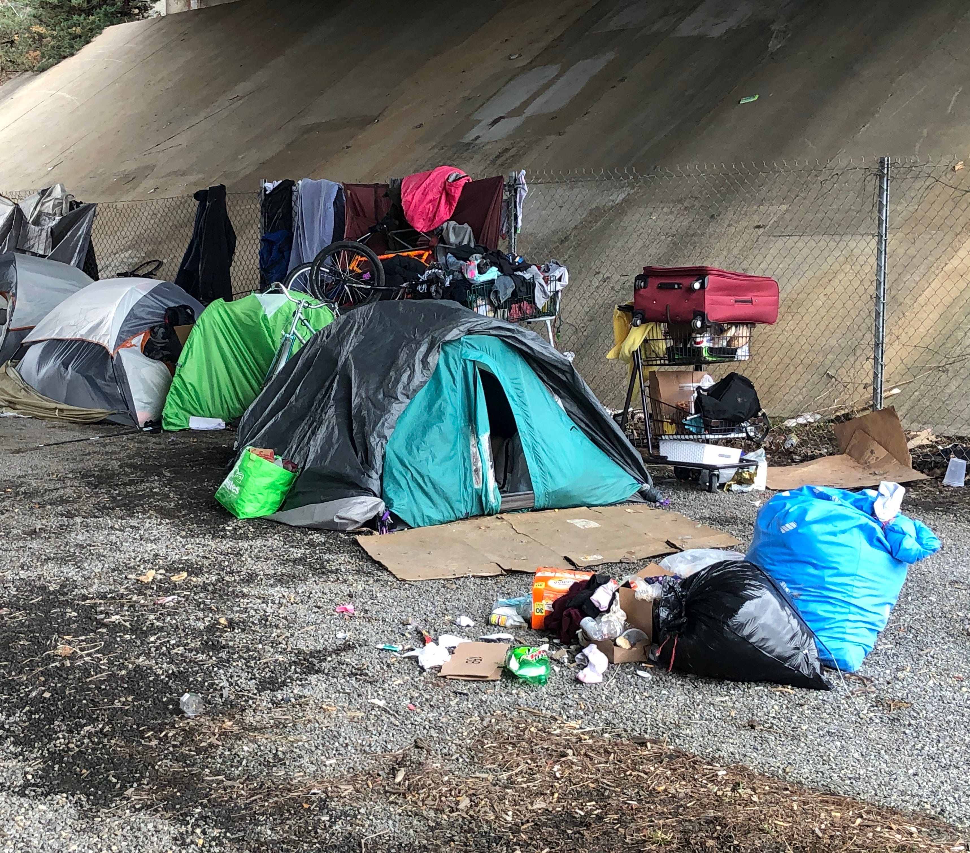
Evaluation Questions: Outreach
How many unique clients is the team engaging with?
How long is the rapport building phase?
What percent of clients encountered become engaged?
Are we covering the geographic region we intend to?
Are we spending our time with clients who are truly unsheltered?
What are our housing outcomes?

Slide 6
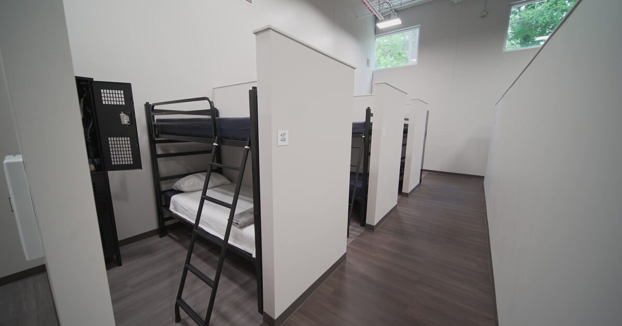
Evaluation Questions: Emergency Shelter
Are we moving people through the shelter quickly? Do we have long term stayers? What are their barriers?
What are the characteristics of those who self resolve? Can we be targeting diversion strategies better?
Who is entering the shelter? Is our front door process efficient? What is our utilization rate?
What are our housing outcomes? Was one month better than another? Was there a reason?
Do we have repeat shelter guests? Are they returning from certain exit destinations?
Who is getting barred/banned from shelter? Any trends?

Slide 7

Evaluation Questions: Permanent Supportive Housing
How long does it take from intake to housing move in date? Are there ways to drive that number down?
What is our housing retention? Are there ways to improve?
Are our tenants gaining income and access to health insurance and benefits in the program?
What are our exit outcomes? Are clients able to “graduate” and move on from PSH?

Slide 8

Evaluation Questions: Rapid Rehousing
How long does it take from intake to housing move in date? Are there ways to drive that number down?
How long are clients utilizing the RRH subsidy?
What are our exit outcomes? Are clients able to maintain on their own? How many need transfers to PSH?
How many families can we serve per year with our current funding? Are there ways to stretch that by using it more effectively?

Slide 9
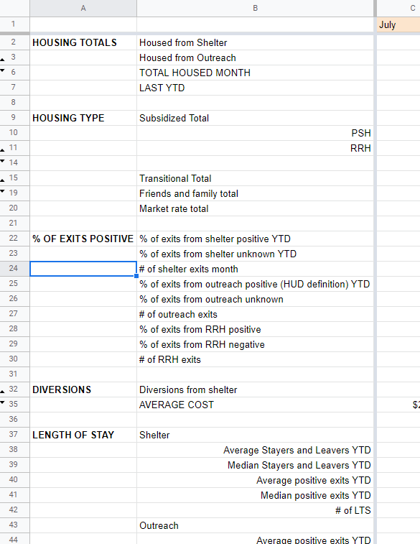
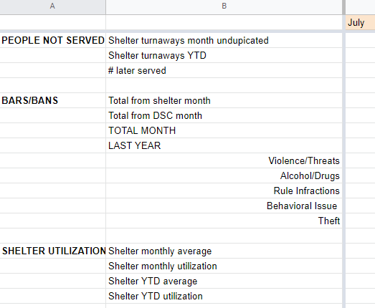
Organize Data Tracking

Slide 10
HMIS Tools: Canned Reports
Report | Use
CoC APR | # served, client demographics, exit destinations, number housed
ESG CAPER | # served, client demographics, exit destinations, number housed, rate of engagement (for outreach)
Clients Served | # of distinct clients served based on type of service provided or shelter stays in a date range
Referrals | # of referrals incoming or outgoing in a date range, option to sort by many elements
Service Transaction | # of services provided based on service type, in a date range, can sort by need outcome (met or unmet)

Slide 11
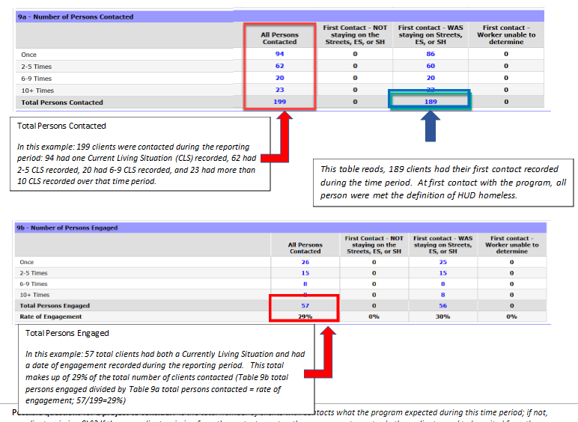
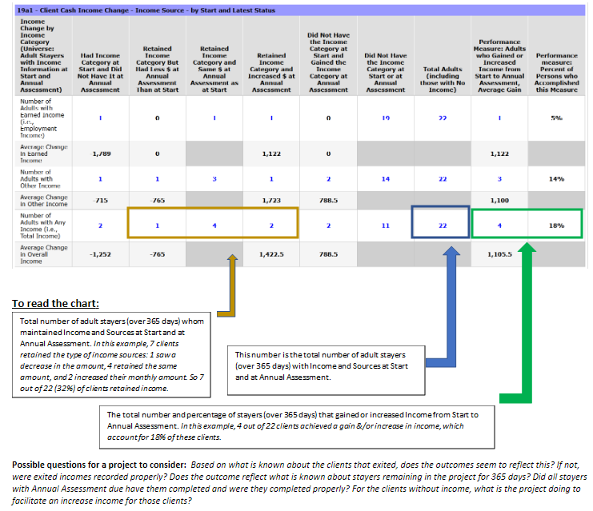
CoC APR Performance Outcome Guide

Slide 12
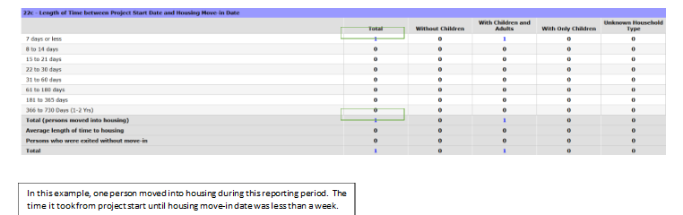
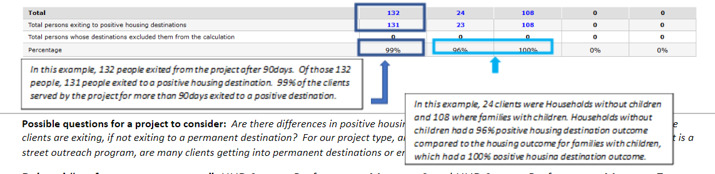
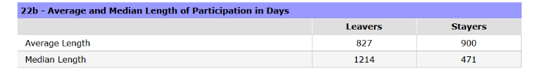
CoC APR Performance Outcome Guide

Slide 13
HMIS Tools: Business Objects Reports

Slide 14
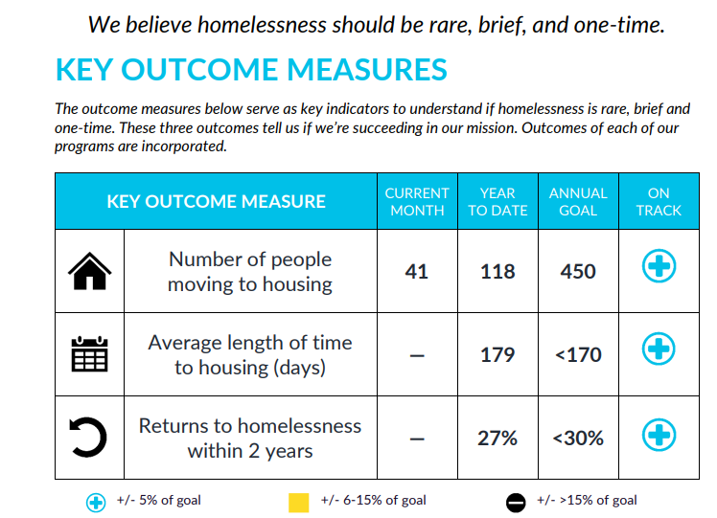

Slide 15
