Slide 1
BusinessObjects

Slide 2
Welcome to BusinessObjects

Slide 3
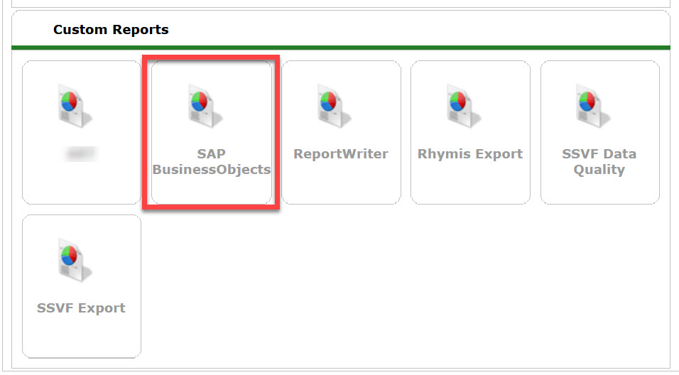
Accessing BusinessObjects
There are two ways to open BusinessObjects:
Click on the Connect to BusinessObjects link found in the upper right corner of HMIS (below Back Date Mode)
Click on Reports from the menu on the left side of the HMIS dashboard. Then click on SAP BusinessObjects

Slide 4
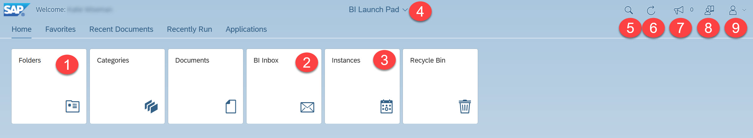
BI Launch Pad
"Folders (formerly ART Browser)" : opens the folder structure to locate the individual report(s)
"BI Inbox (formerly inbox)" : opens the inbox which contains the last year of scheduled reports assigned to the inbox
"Instances (formerly Scheduled Reports)" : opens a list of reports scheduled within the last 60days
"BI Launch Pad (new feature)" : This menu can be utilized to flip between different open reports
"Search Tool" search for reports by name
"Screen Refresh" : refresh your BusinessObjects Home Page, if needed
"Announcements" : These are announcements that are made by the vendor.
"User Guide" : user guide created by the vendor
"User Settings" : This allows customization of BusinessObjects Launch Pad.

Slide 5
Report Folders

Slide 6
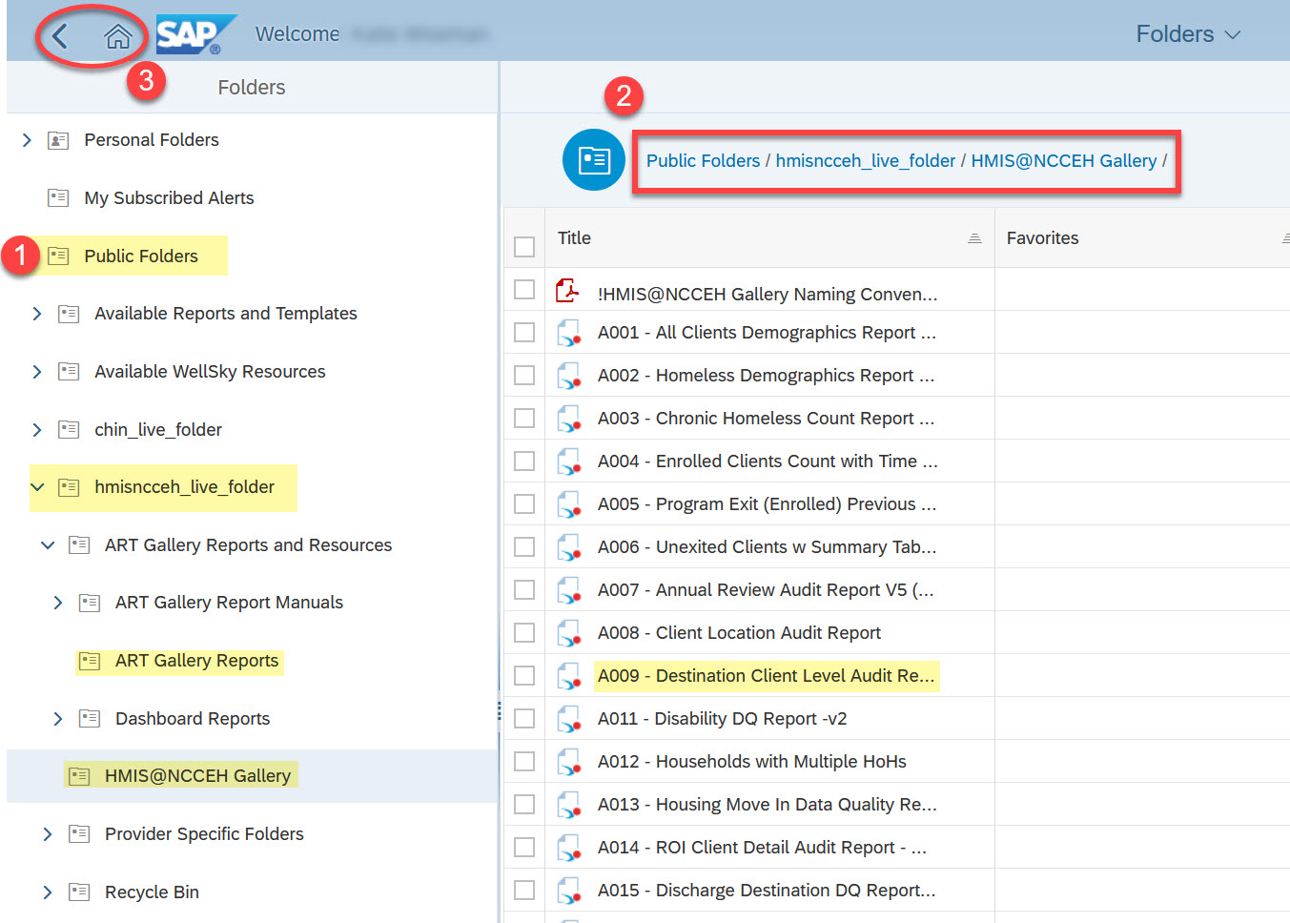
Accessing Reports
From the Folders tiles:
The subfolder structure will appear, from which you can navigate to the individual reports
As you open folders, they will be added to the breadcrumb trail. Jump to a folder by clicking on its name in the breadcrumb trail.
To return to the home screen, you can click either the Back button or the Home button.
Reminder! The “ART Gallery Reports” are vendor created reports. The “HMIS@NCCEH Gallery” are custom reports specific for this implementation.

Slide 7
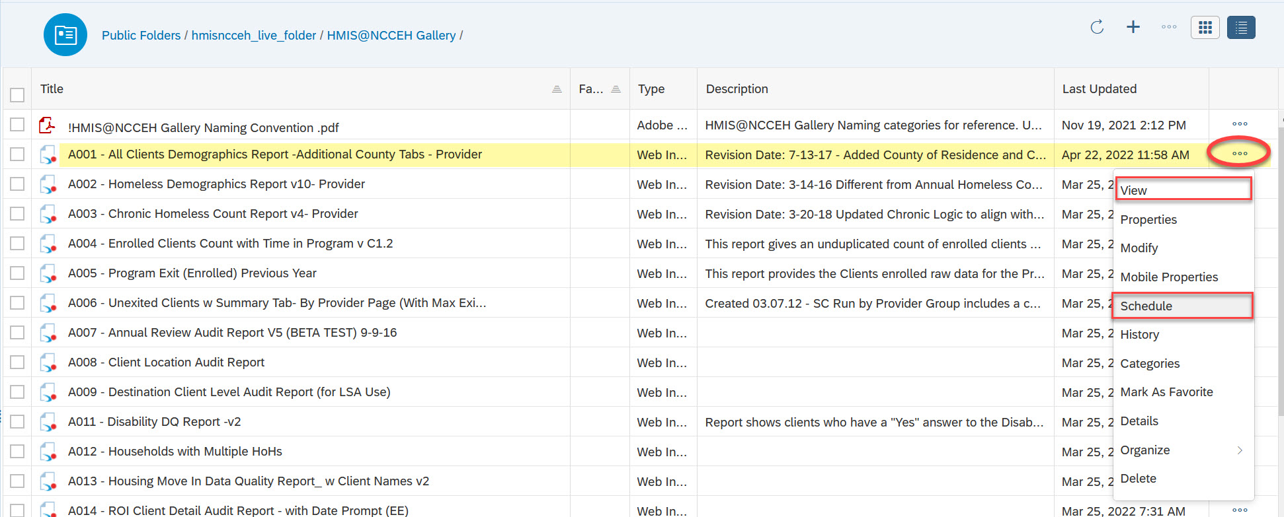
Report Folder Actions
Click on the Actions icon to see a list of available report actions.
Available Actions:
View or Schedule: used to run reports
History: displays past report “instances”, or saved copies, previously scheduled
Details: displays additional information about a report

Slide 8
Running Reports

Slide 9
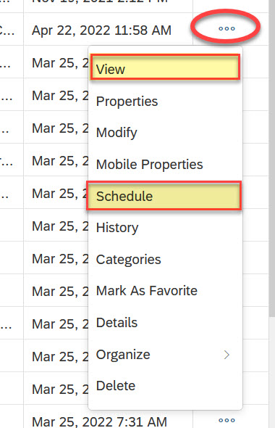
There are two options to run reports:
Clicking on the name of the report or selecting the View option from the actions menu opens in View Mode. This mode lets you run a report immediately.
Selecting the Schedule option from the actions menu lets you schedule a report to run at a chosen time. You can also open the actions menu by clicking on its icon or by right-clicking on a report.

Slide 10
Length of Stay/Exit Destination Reports

Slide 11
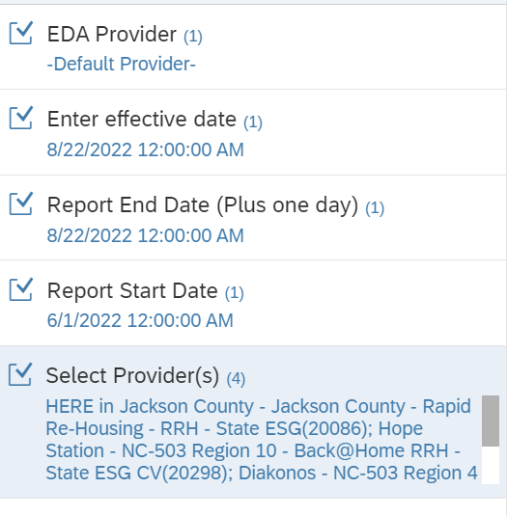
C010 Housing Move-in Date and Project Enrollment
Tab 1 shows all active clients with a HMID, sorted newest to oldest, with the length of time from intake to housing, and average and median length of time to housing.
Tab 2 shows active clients without a HMID and length of time in the program.
Tab 3 shows all clients who have exited in the date range, the exit destination, and length of time in the program.

Slide 12
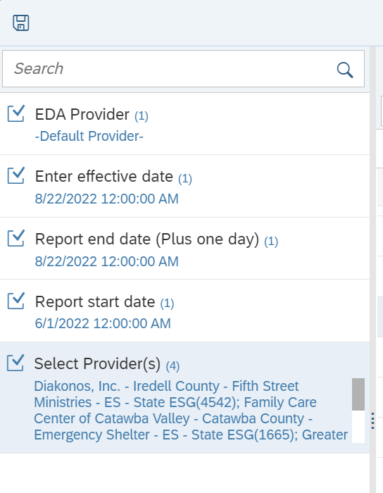
C011 Shelter Stayers, Leavers and Exits Dashboard Report
This report has 4 tabs. The first tab, “Stayers” lists all clients with an open project entry, demographic info, length of stay, and average and median length of stay.
The second tab, “leavers” lists all clients who exited in the report date range, the length of stay in the project, exit destination and notes, and exit type.
The third tab, “Stayers and leavers” list all clients from the first two tabs. The 4th tab has charts analyzing the exits, showing average and median LOS by exit type, and exit rates by type.

Slide 13
Client Demographics Reports

Slide 14
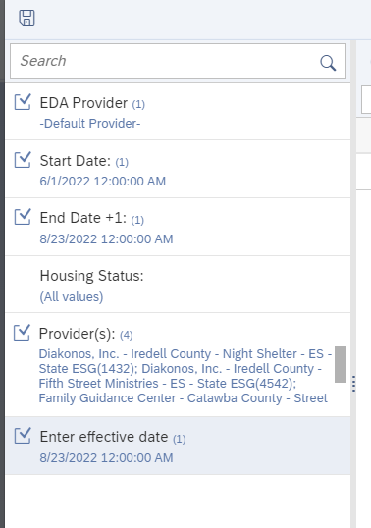
A001- All Clients Demographics Report w/ County Tab
Has many tabs (Single adults, veterans, seniors, families, etc.) with client count totals for various demographics, including counts by county. Has client detail tabs for reference or further analysis.
Note the tabs do not split out the data by project, if multiple projects were pulled in.

Slide 15
Data Quality Reports

Slide 16
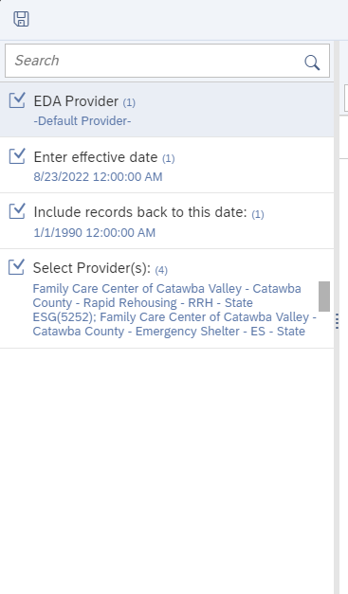
ART Gallery 0220 Data Incongruity Locator- Age, Gender, Household relationship issues
This data quality report assists users in locating data entry errors resulting in incongruous information related to the client's recorded age, gender and/or household relationship(s). Both summary and detail information is displayed for 12 different types of errors. User prompts allow both provider(s) and date range to be specified.
Examples of errors this report looks at are DOBs that results in a negative age or an age over 100 years, clients with a veteran status of “yes” and an age under 18, etc.

Slide 17
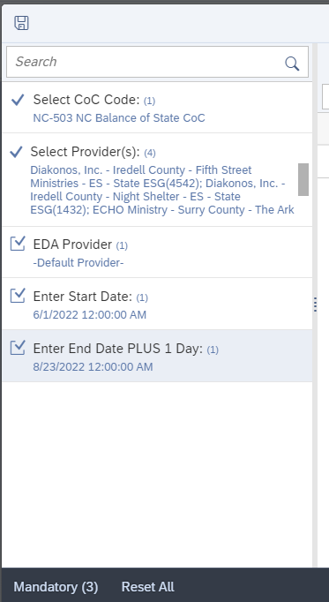
ART Gallery 0226- Head of Household and Client Location
This report is intended to check for “Relationship to Head of Household” and "Client Location" data quality errors for projects using an Entry/Exit workflow. Shows errors for multiple Heads of Household in a household (Tab B), missing relationship to HoH (Tab C), and missing client location (Tab D)

Slide 18
A011 & A003 for Disability DQ Checks
A011: Disability DQ Report
Shows who has a “yes” to the gateway question but there are no disabling conditions marked “yes”
A003: PSH Chronic Homelessness Check
Tab 3 shows who has a “no” to the gateway question but have a “yes” to one or more of the disabling conditions

Slide 19
Additional Information

Slide 20
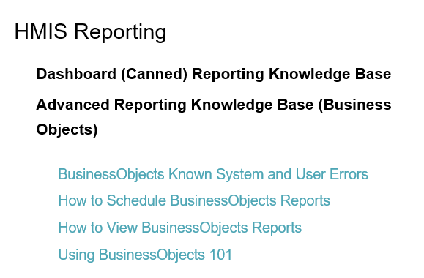
Have a Question About a Report?
Check out the detailed ZenGuide reference sheets put together just for BusinessObjects!
https://ncceh.zendesk.com/hc/en-us
If you still have questions, contact the HMIS@NCCEH Data Center at: hmis@ncceh.org
To ensure we can offer the best possible support, we recommend the following:
Schedule the report, using the Microsoft Excel file format.
Include the report’s name and prompt values in your email.
Share any client ID numbers of interest.
If you choose to attach a copy of the report or include any screenshots, please remove any Personally Identifiable Information (PII) like client names or Social Security Numbers first!

