Slide 1
NC Balance of State
Continuum of Care
New ESG Applicant Webinar
November 27, 2018
9:30 AM
Notes:
BRIAN
Good morning!
Make introductions of BoS staff!

Slide 2
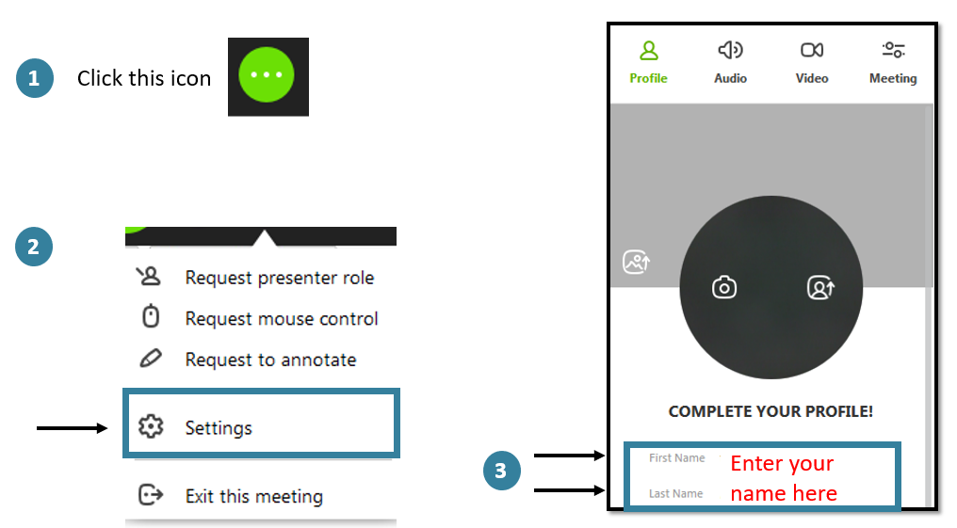
Attendance
Participants should enter their full name so we know they are here and included in the minutes.
Notes:
BRIAN

Slide 3

Welcome
Reminders
  *6 to mute/unmute line
  Please do not put us on hold
  The chat box is available
This box is located in the top, center of your screen
Notes:
BRIAN
Everyone is currently on mute. We encourage your questions though. To unmute your line, please press *6 to speak and then again press *6 to mute your line again
Please do not put us on hold, as we will all be subjected to your hold music.
We want to encourage the use of the chat box. I will monitor the chat box for activity and make sure we respond to your questions. The top menu bar on your screen has a green chat bubble icon you can click if you prefer to ask questions or make comments there.
HIT the RECORD button!

Slide 4
Agenda
Notes:
BRIAN

Slide 5
Today’s agenda
ESG program overview
Compliance
Coordinated entry
HMIS
Administration
Next Steps
Notes:
BRIAN

Slide 6
ESG Program Overview
Notes:
JENN

Slide 7
HUD sets priorities for the ESG program
Broaden existing emergency shelter and homelessness prevention activities
Emphasize rapid re-housing
Help people quickly regain stability in permanent housing after experiencing a housing crisis and/or homelessness
Despite activity type funded, ESG funding should be assisting people to access or maintain permanent housing!
Notes:
JENN

Slide 8
ESG:
Emergency Solutions Grants
Purpose:
Provide assistance to rapidly re-house persons who are currently experiencing homelessness.
Assist in meeting the costs of operating emergency shelters
Restrict the increase of homelessness through the provision of preventive programs and activities
Notes:
JENN

Slide 9
5 eligible components under ESG
Emergency Response
Housing Stability
Emergency Shelter
Street Outreach
Rapid
Re-Housing
Targeted Prevention
HMIS
HMIS
Notes:
JENN
The Emergency Solutions Grant program funds five different activities broken into two components: Emergency Response (programs working with people while literally homeless) and Housing Stabilization (programs helping people to access permanent housing). The Emergency Response activities are Street Outreach and Emergency Shelter. The Housing Stabilization activities are Rapid Re-Housing and Homelessness Prevention. The fifth activity is work with the Homeless Management Information System or HMIS which supports the other four activities. HMIS activities are inclusive of funding for using a comparable database used for victims’ service providers who are prohibited from using a traditional HMIS.
Now, we will briefly go through each of these activities with the target population and eligible services that can be reimbursed with ESG program dollars. NOTE: Just because a service is eligible for ESG funding does not mean that your program can spend their ESG dollars on the service. Programs should refer back to their specific program budget to determine if they budgeted ESG dollars for the service. If it is not in your approved (and contracted) ESG budget, it is not eligible for reimbursement from the ESG office.

Slide 10
Flow of ESG funds
Entitlement Communities
(none in BoS)
HUD
DHHS
Agencies
Notes:
JENN

Slide 11
Street outreach
Serves unsheltered homeless individuals
  Assertive outreach
  Passive outreach
Essential services:
  Engagement
  Case management
  Emergency physical and mental health services
  Transportation
Notes:
BRIAN
Assertive outreach is outreach to unsheltered individuals on the streets, in campsites, libraries, malls, or places not meant for human habitation (abandoned buildings, bus or train stations). This could also include outreach and engagement where someone is flying a sign on the side of the road or near exit ramps. Basically, your program would be seeking unsheltered people where they are in the community, on their turf. Often this type of outreach is done at odd hours, potentially on the weekends and requires programs to have strong, detailed procedures to ensure safety of staff and clients.
Passive outreach is outreach and engagement of unsheltered people at service centers. This could be soup kitchens, feeding centers, local DSS’s, or at agencies in your community that offer basic needs where unsheltered individuals may present themselves on a regular or semi-regular basis to meet their needs. Your program could have an agreement with these agencies or programs to show up at a specified time during the week to interact and engage people that need access to emergency and/or permanent housing.
Effective street outreach programs should use a mixture of both of these types of outreach to engage as many unsheltered individuals in your community as possible.

Slide 12
Emergency shelter
Serves people staying in emergency shelters
Essential services:
  Case management
  Child care, education, employment, and life skills services
  Legal services
  Health, mental health, and substance abuse services
  Transportation
Operations
Notes:
BRIAN
People served in shelter with ESG funding should have been literally homeless prior to entry into the program or facing imminent homelessness from a housing situation. They should have no other options for a permanent housing situation, reserving spaces for people that cannot find other supports to keep them out of shelter. Emergency shelter programs should operate with low barriers to entry: not require sobriety, income, proof of identification, or put in other barriers to entry; not conduct criminal background checks or prevent people with histories of incarceration or arrest in the shelter; not prevent people from re-entering shelter after leaving – no time limit; not ban people for reasons other than threats to safety of other shelter residents or shelter staff; program rules and expectations should focus only on health and safety.
Services should be housing-focused, centered on helping people identified safe, accessible, permanent housing solutions from their first day in shelter. Every case management conversation should relate to PH. Services should not require residents to participate in certain services or meet prerequisites prior to moving into PH.
Operations: Maintenance, utility payments, furniture, food – things that help the emergency shelter operate on a daily basis

Slide 13
Rapid Re-Housing
Serves literally homeless individuals/families
  Emergency shelters
  Unsheltered people
  People fleeing domestic violence situations
Eligible activities:
  Housing location services
  Financial assistance (up to 24 months)
  Stabilization services
Notes:
BRIAN

Slide 14
Homelessness Prevention
Serves people imminently at-risk of homelessness at and below 30% of Area Median Income
  Stay in current housing
  Move into other sustainable housing
Eligible activities:
  Housing location services
  Financial assistance (limited)
  Stabilization services
Notes:
BRIAN
For all NC BoS CoC homelessness prevention programs, only households that have been in a supportive housing program – PSH or RRH – previously is eligible for funds this year.

Slide 15
HMIS
Support entry of data for other ESG activities
Eligible costs:
  Computer hardware, software
  Office space, utilities, and equipment
  Salaries for HMIS entry
  Staff travel for training/intake activities
  Participation fees (none in NC BoS CoC)
Notes:
BRIAN

Slide 16
Compliance
Notes:
BRIAN

Slide 17
ESG grantees have three levels of narrowing compliance
HUD Compliance
  ESG Regulations: https://www.hudexchange.info/resources/documents/HEARTH_ESGInterimRule&ConPlanConformingAmendments.pdf
State ESG office Desk Guide:
  https://files.nc.gov/ncdhhs/NCDHHS_Desk%20Guide%202018_FINAL5.pdf
NC BoS CoC Written Standards
  http://www.ncceh.org/bos/
Notes:
BRIAN
ESG grantees must operate their programs within three levels of compliance.

Slide 18
Coordinated Entry
Notes:
Bagé
Coordinated Entry / Coordinated Access / Coordinated Assessment – all interchangeable – the NC BoS CoC has begun using the term coordinated entry to match HUD’s use of the term
All ESG grantees must actively participate in the CoC’s coordinated entry process, meaning that they must conduct assessments where applicable, enter collected data into HMIS and/or provide information to the regional CE Lead, attend local case conferencing meetings, for RRH and homelessness prevention programs only accept referrals from the community’s prioritization waiting list, and assist the region to evaluate and improve the CE system.

Slide 19
Coordinated entry systems help people find permanent housing
Creates defined access points into homeless system with clear referral system to emergency services
Assesses all individuals experiencing homelessness the exact same way for permanent housing
Permanent housing programs take all referrals through the CE system (not first-come, first-served)
Notes:
Bagé
Provide emergency room analogy

Slide 20
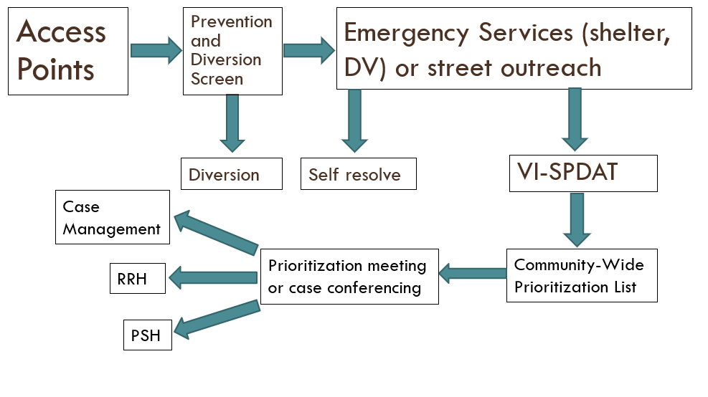
NC BoS CoC coordinated entry system
Notes:
Bagé
The NC BoS CoC has a general framework for its coordinated entry system defined by our coordinated entry written standards. These written standards follow HUD rules and guidelines for how coordinated entry systems should operate within the CoC. Because the NC BoS CoC covers 79 counties, we understand that to implement the exact same process in some very diverse and unique communities would be extremely difficult. So to allow local communities flexibility to implement the framework established under the CE written standards, each Regional Committee has developed its own regional CE plan. Your agency and program staff should become familiar with your local plan. These plans are posted under the Regional Committee page on the NCCEH website. If you are not already an active participant in your region’s CE system, you should contact your local Regional Committee CE Lead to determine how to get involved.
Here’s roughly how the CE system in all regions looks. Someone shows up at an access point, they always receive the prevention and diversion screen. This screen isn’t about prioritization, it’s about assessing someone’s need for emergency services and possibility to divert them from the homeless system. They get referred to emergency shelter, domestic violence shelter, or diverted. They may also be engaged by street outreach, which is somewhat different. If they go to shelter, regions usually wait 12-15 days to do a VI-SPDAT – that’s to see if we can help more people self-resolve. If they’re still in the shelter after that time, or if they’re working with street outreach and clearly chronically homeless, we fill out the VI-SPDAT. That’s the shared prioritization. They usually then go on a community-wide prioritization list. There’s a meeting to discuss each case, then they get referred, based on their score and other factors.

Slide 21
Access points
“Front Door” to the homeless system
Administer Prevention and Diversion Screen, then make appropriate referral (with warm handoff), as needed
Ideally, no one gets a shelter bed or receives diversion assistance without having a Prevention & Diversion screen completed first (unless their safety is in jeopardy)
Notes:
Bagé

Slide 22
Shelters as access points
Shelters can be the access points for the CE system
They must do the P&D screen on everyone who comes in their doors and make referrals appropriately, regardless of whether someone is eligible for their program.
Notes:
Bagé

Slide 23
Access points
Prevention & Diversion Screen, with training, is available here:
  http://www.ncceh.org/bos/coordinatedassessment/
Notes:
Bagé

Slide 24
VI-SPDAT
Shared assessment tool that screens for someone’s vulnerability to mortality and appropriate fit for housing programs
  Only administered to literally homeless households
  For newly homeless: administered 14 days after entering shelter
  For unsheltered homeless, can be administered immediately, if necessary
Notes:
Bagé
Vulnerability Index Service Prioritization Decision Assistance Pre-Screen Tool

Slide 25
VI-SPDAT
VI-SPDAT, with training, available here:
  http://www.ncceh.org/bos/coordinatedassessment/
Notes:
Bagé

Slide 26
Prioritization Waiting List
Once VI-SPDAT completed, information referred to CE Lead for inclusion on region’s prioritization waiting list
List prioritized based on VI-SPDAT score and other agreed-upon factors:
  Factors could include: DV, being unsheltered, emergency room visits, Veterans, etc.
  Factors that cannot be included: Income (or lack of), gender, race, disability, substance abuse history, criminal history
Notes:
Bagé
The idea is to screen-in people who need housing the most not screen out people who already have barriers to housing!
For ES or SO programs that are also operating RRH programs through ESG, remember that these programs operate separately within the CE system. When your ES or SO program assesses participants with the VI-SPDAT, all information should be sent to the regional CE Lead for inclusion on the community’s prioritization waiting list. Direct referrals from an agency’s SO or ES program should not be made to the same agency’s RRH program. RRH programs should only be taking referrals from the prioritization waiting list at the region’s case conferencing meeting or from the CE Lead who maintains the list. The reason the VI-SPDAT scores are sent to the CE Lead is so households can be placed on the waiting list to determine which household has the highest priority for permanent housing.

Slide 27
Case Conferencing
Case conferencing is a regular meeting where all providers come together to:
  Refer and select households
  Troubleshoot and get advice
  Seek other housing options (than CoC- or ESG-funded housing programs)
  Handle exceptions
Notes:
Bagé
Generally one key manager from each program should participate in case conferencing – someone who has high level knowledge of all the clients and their program’s capacity. Shelters/outreach programs need to be there to help refer their clients, PSH, RRH programs need to be there to take clients. Everyone needs to be there to help troubleshoot, etc.
The hard ones – those who only get case management, or fall at the bottom of RRH, are good topics.
Don’t have to talk about everyone, but it’s good to just check – if it’s quick – that’s fine.
Exceptions: What is they’re from a different county? What if they are not eligible for the CoC and ESG programs available?

Slide 28
Lowering Barriers
CE does not work if programs have too many barriers to entry!
Programs should lower their eligibility criteria to the bare minimum in order to have a system that best serves people experiencing homelessness.
Notes:
Bagé

Slide 29
Case Management Tool
Third part of coordinated entry in NC BoS CoC
  Assesses client’s progress toward stability and independence
  Required for housing programs to determine levels of assistance needed over time
Case management tool, with training, available here:
  http://www.ncceh.org/bos/coordinatedassessment/
Notes:
Bagé

Slide 30
Resources
All forms and trainings on each form, as well as the NC BoS CoC Coordinated Entry Written Standards, are available at:
  http://www.ncceh.org/bos/coordinatedassessment/
Notes:
Bagé

Slide 31
HMIS Introduction
Notes:
Brian
Mention comparable database for DV service providers
Request license by December 7th.

Slide 32
HMIS Introduction Agenda
What is HMIS
How to get access
Data Collection and Entry Essentials
Keep NC Safe
Notes:
Brian

Slide 33
H | Homeless
M | Management
I | Information
S | System
Notes:
Brian

Slide 34


HMIS data will help end homelessness
HMIS data influences policy
HMIS data helps communities
Notes:
Brian
HMIS is so much more than a requirement!

Slide 35
HMIS provides state level data
Notes:
Brian
Took this data to capitol hill to advocate for more funding for vet homelessness in NC.

Slide 36




HMIS Role: End User or Case Manager
Record client engagement
Follow policies and procedures
Attend trainings for HMIS to stay updated
Notes:
Brian

Slide 37


HMIS Role: Agency Administrator
Act as the FIRST point of contact
Ensure compliance with established policies and procedures
Attend trainings and meetings related to HMIS
Maintain data quality standards
Notes:
Brian
We call them Aas; consider who should be your AA carefully.

Slide 38
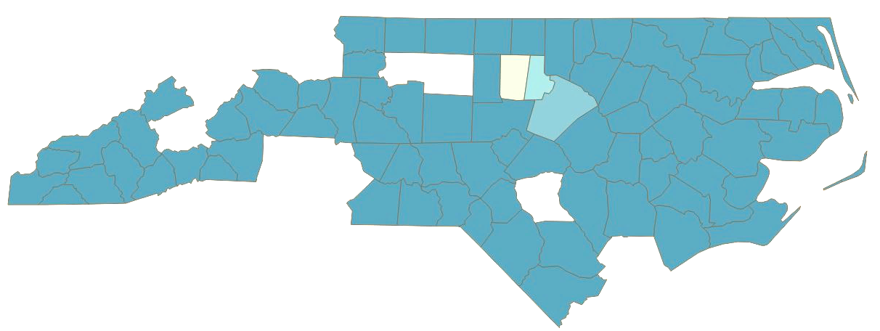
NCCEH’s Data Team Covers 81 Counties in NC
Orange
Durham
NC Balance of State CoC
Notes:
Brian

Slide 39
How to get access
Notes:
Brian

Slide 40
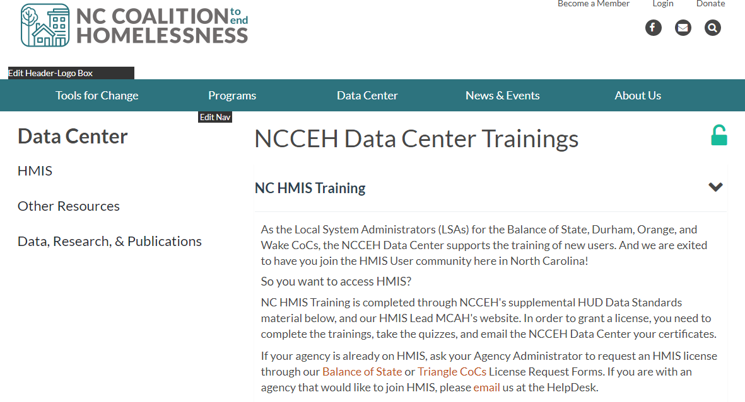
Request HMIS Licenses by Dec 7
Submit a NC Balance of State CoC License Request Form from ncceh.org/hmis/trainings
Notes:
Brian

Slide 41
The Training Process
Send Agency, Project, and User details via Form Take Trainings Online, send certificates Sign Documents Online Contact the Data Center at any point for any and all questions!
Notes:
Brian
The Data Center sends a guide specifying the training certificates that are needed. Please follow that guide so you take the minimum required trainings.

Slide 42
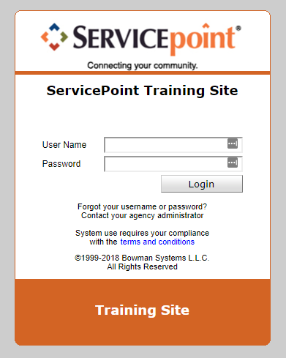
Practice as you train
The Data Center can give you customized login access, please request via email: hmis@ncceh.org
Notes:
Brian
Test site – you can create or modify fake clients

Slide 43

Data Collection essentials
Notes:
Brian
At the section title, remind attendees that we’ll review the framework and the ins and outs of the topic, and then we’ll have an example to practice at the end of this section.

Slide 44
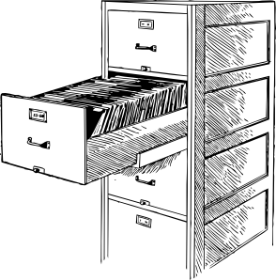

HMIS client record = Electronic client file
HMIS
Client Record
Notes:
Brian
Explain client record first. In HMIS a client should only have 1 file.
1 client=1 file.

Slide 45
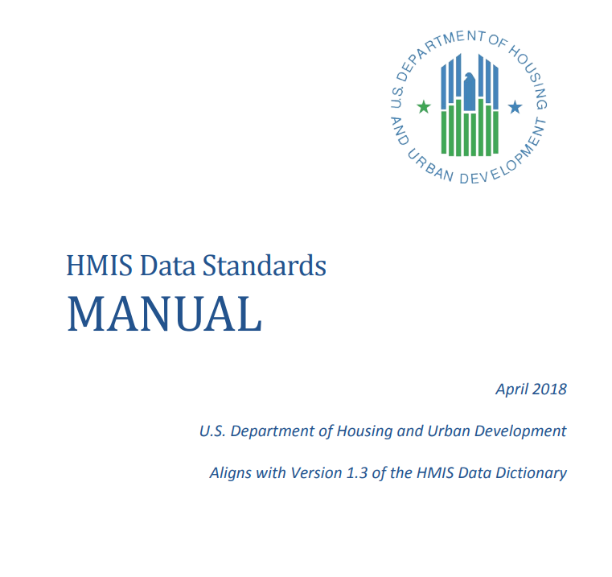
The data you enter into HMIS MATTERS!
Universal Data Elements
&
Project Specific Elements
Click on image for the HUD Data Standards Manual
Notes:
Brian
We can’t stress enough how much your HMIS data matters
The AHAR report is built on the UDEs you enter for clients such as gender, entry date, etc.
It’s also dependent upon the project descriptor elements you entered at migration such as project type and bed and unit inventories

Slide 46
Universal Data Elements (UDE)
Required for all
Critical to federal reporting
  LSA, PIT, APR, CAPER, HOPWA, SSVF upload, etc.
Useful to track
Establish the baseline data for analysis
Notes:
Brian

Slide 47
Universal Data Elements
Name
Social Security Number
Date of Birth
Gender
Race
Ethnicity
Veteran Status
Disabling Condition
Project Entry Date
Project Exit Date
Destination
Relationship to Head of Household
Client Location
Housing Move-In Date
Living Situation
Required for all projects participating in HMIS, regardless of funding source
Notes:
Brian

Slide 48






HMIS Data Collection Stages
Record
Creation
Project Start
Update
Annual
Review
Project Exit
Post Exit
NO
Client
Record
365
When client record is created
At every project start
At multiple points during project enrollment
Recorded no more than 30 days +/- the anniversary date of the HoH’s Project Start Date
At every project exit
Follow-up after project exit
(optional)
Notes:
Brian
Snapshot moment for the client as they are enrolled in your project. Move in dates recorded as updates for permanent housing projects. Post-Exit is “follow-up” in HMIS, and should be used for up to six months after exit.

Slide 49


Null Response Categories
Client doesn’t know | Should only be used when the client does not know the response
Client refused | The client refused to provide data
Data not collected | Case manager or data entry staff forgot or was unable to ask
Remember: only accurate data should be entered into HMIS and clients always have the right to refuse answering.
Notes:
Brian
Missing and Null responses will always be flagged. ESG Standards are under 10% for any given data element

Slide 50
Reporting with the ESG CAPER
Grantees must submit an annual CAPER to State ESG Office
  Unique link to Sage will be sent to each grantee
  Use the Data Center’s guide for How to Run and How to Read the ESG-CAPER
Data Quality review (all data elements missing less than 10% on any report)
Demographics and outcomes for clients de-identified
Notes:
Brian
State ESG office will collect ESG CAPER and other reports as needed for ongoing tracking.

Slide 51

Keep NC safe
Go to ncceh.org/hmis/privacy for a desk guide and more details
Notes:
Brian

Slide 52





Data security depends on all of us
Protect sensitive data
Practice good password management
Never leave your computer unattended
Keep software up to date
Install anti-malware protection
Notes:
Brian

Slide 53
Data Center Contact Info
ncceh.org/hmis
access local support for NC Balance of State, Durham, & Orange CoCs
919.410.6997 or hmis@ncceh.org
helpdesk for local support
Notes:
Brian

Slide 54
Administration
Notes:
Jenn

Slide 55
Grantees should read, understand, and follow their ESG contract!
Notes:
Jenn
Make sure all agency staff that will be handling ESG-related activities know what is required under the ESG program contract: Executive Director, finance staff, program directors, program staff providing services directly to participants.

Slide 56
ESG is a reimbursement-based grant
Agencies must expend their dollars for services and activities first and then ask for reimbursement.
  Must use ESG forms with required documentation
  Programs must submit reimbursement monthly
ESG office will hold mandatory webinars on the reimbursement process!
  Be on the lookout soon for dates!
Notes:
Jenn
Must submit a $0 requisition, if there are no expenses in the month.
Must have expenses at least once a quarter.
The ESG desk guide will have specific information about when reimbursements must be submitted each month.

Slide 57
ESG requires documentation in client files
All activities have documentation requirements. Forms can be found at:
    ESG Required Forms
    ES and SO Client File Checklist
    HP and RRH Client File Checklist
ESG office will do desk reviews and on-site monitoring of grantees in 2019
Notes:
Jenn
Required forms periodically change – the ESG office normally sends an email announcement to the designated ESG representative identified on the original application. However, it is good practice to look at the ESG office website each month to ensure that programs are using the correct and most up-to-date forms.

Slide 58
Grantees need to spend their dollars!
Many 2018 ESG grantees were put on corrective action this year or had contracts rescinded because of underspending their ESG dollars.
  The ESG office expects that grantees to spend according to this chart:
Date Expenses Incurred | Percentage of Budget
03/31/19 | 25%
06/30/19 | 50%
09/30/19 | 75%
12/31/19 | 100%
Notes:
Jenn
GET STARTED EARLY! The ESG office will not give new grantees start up time. They will expect new grantees to meet these spending thresholds. If program’s need to hire staff, train personnel, get policies and procedures in order, put together administrative practices, get HMIS licensure, etc, this needs to be done prior to the operating start year so that program can begin their programs on January 1, 2019.
If you need a budget revision, contact the ESG office!

Slide 59
Grantees will need to provide Quarterly Progress reports throughout the year
Quarter | Due Dates
Quarter 1: January 1 – March 31, 2019 | April 30, 2019
Quarter 2: April 1 – June 30, 2019 | July 31, 2019
Quarter 3: July 1 – September 30, 2019 | October 31, 2019
Quarter 4: October 1 – December 31, 2019 | January 31, 2020
QPRs require grantees to run multiple HMIS/comparable database reports and enter information into a template provided by the ESG office.
Notes:
Jenn

Slide 60
Wrap Up
Helpful hints to get started:
  Contact NCCEH Data Center for HMIS access
  Reread your application and budget
  Familiarize yourself with ESG contract requirements
  Read NC BoS CoC written standards for your activity
  Attend ESG reimbursement webinar
  Train all program and admin staff
  Have a plan of action and start early
  Ask questions
Notes:
Brian

Slide 61
When you have questions, we can help!
ESG Office
NC BoS CoC staff
Contract issues
Reimbursements
Budget amendments
Corrective actions/appeals
Program design
Direct client issues
CE issues
Regulations
HMIS (Data Center)
QPR (Data Center)
Before reaching out, refer to the ESG Desk Guide. It’s full of good information that can probably answer most questions!
Notes:
Brian

Slide 62
Wrap Up
Keep in touch
  bos@ncceh.org
  (919) 755-4393
ESG office contact info
  Kim Crawford – Homeless Programs Coordinator
  919-855-4991
  kim.crawford@dhhs.nc.gov
Notes:
Brian

Slide 63
Attendance
Participants should enter their full name so we know they are here and included in the minutes.
Notes:
Brian
Don’t forget to close your browser after the webinar. We have recorded today’s webinar and cannot download the recording to post and email out until everyone has closed join.me.

