Slide 1
2019 PIT – Unsheltered App Training
January 2019

Slide 2
Agenda
PIT Cout Basics
PIT Count Data Collection
HarvestYourData App
Test, test, test

Slide 3
PIT Count Basics

Slide 4




What is the Point-In-Time Count?
A count of all people experiencing literal homelessness in the community on specified night
Includes people staying in an emergency shelter incl. a DV shelter
Includes people living in transitional housing
Includes people living outdoors including in cars, parks, bus depots, and abandoned locations

Slide 5


When is the Point-In-Time Count?
The 2019 PIT Count is on the night of Wednesday, January 30th
Some communities complete service-based counts during the 7 days after PIT night where people are asked PIT questions when they present for services

Slide 6
PIT Count Data Collection

Slide 7



How will PIT Counts be conducted?
HMIS reports will be used by shelters and transitional housing projects that have HMIS access
Paper surveys will be used by shelters and transitional housing projects that do not have HMIS access
HarvestYourData app will be used for the unsheltered count

Slide 8
HarvestYourData App

Slide 9


Benefits to using tech for unsheltered count
Volunteers can easily complete and upload interviews
Eliminates need of carrying paper and clipboard everywhere
Built in skip logic customizes interview process
Compatibility with tablets, Android phones, and iPhones
Notes:
Not having a clipboard also makes you seem more approachable and can help build rapport quicker

Slide 10

What data does the app survey collect?
Personal Information
 | Demographics
 | Education level
 | Employment History
 | Household Type
Housing Information
 | Past housing history
 | Current housing needs
 | Total time homeless
 | Connection to housing

Slide 11

How can I access the app?
Install the app on your tablet or phone:
Android Users will download droidSurvey from Google Play Store
Notes:
Comes up as droidSurvey Offline Forms

Slide 12

How can I access the app?
Install the app on your tablet or phone:
iPhone users will download iSurvey from the Apple Store
Notes:
Comes up as iSurvey Offline Forms

Slide 13
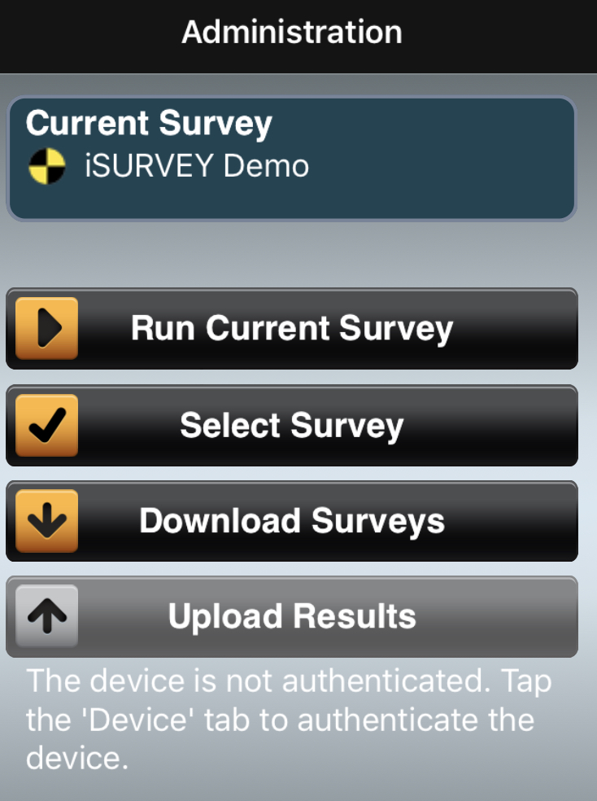
Register to get survey
After installing the app, go to the Administration screen of the survey
The device needs to be registered or “authenticated” before it can access the survey

Slide 14
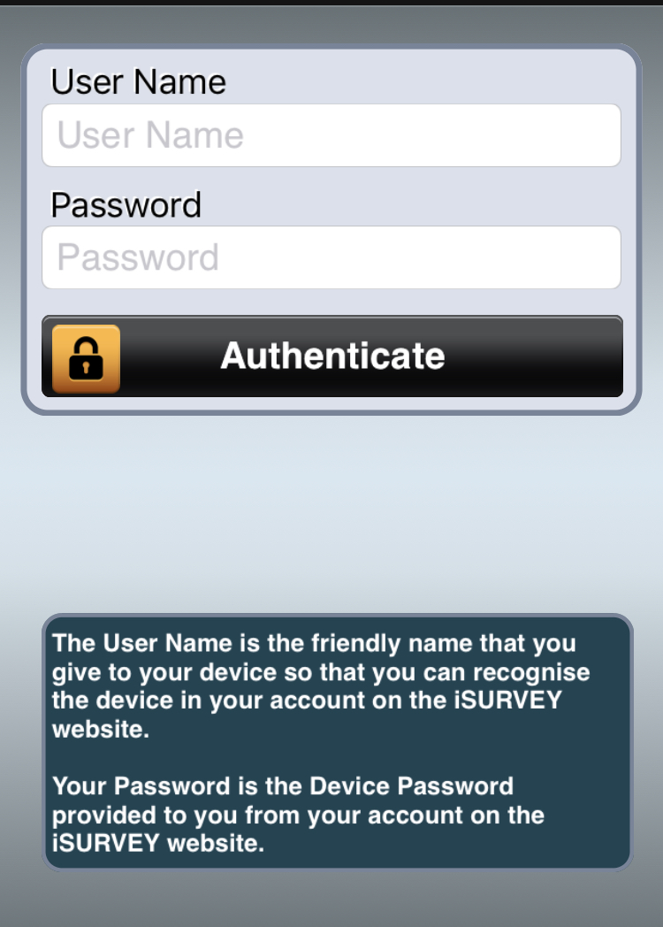
Enter username and password
Next, go to Device tab to enter your User Name and Password
The User Name will be first initial followed by last name, then a hyphen, followed by “bos”:
For example, my username is jvolkel - bos
Everyone’s password is 599170

Slide 15
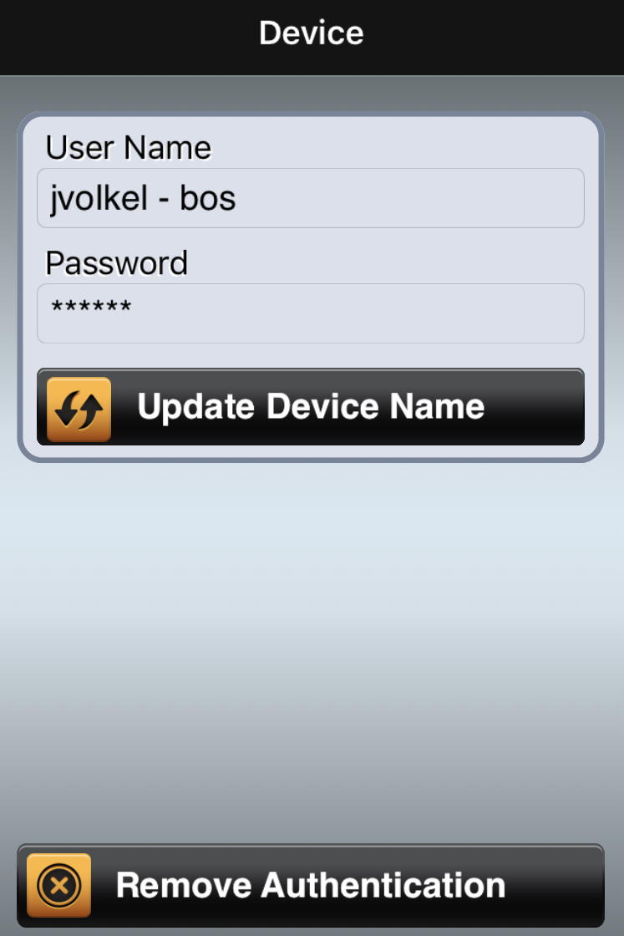
Completed Registration
This is how an registered/authenticated device will appear after entering User Name and Password

Slide 16
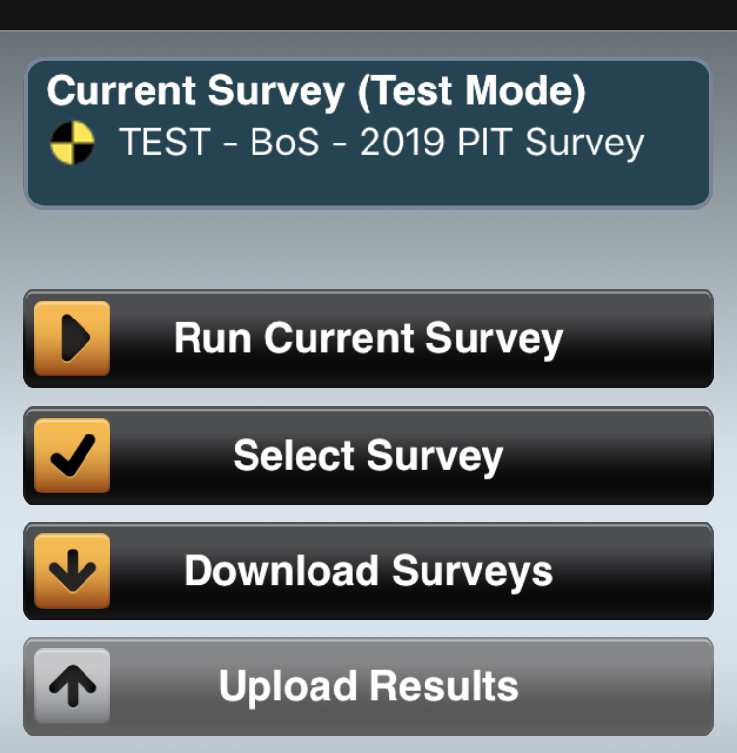
Download the Survey
Return to Admin screen and wait for NCCEH Data Center to give access
Click Download Surveys to run the survey offline
TIP: GPS tracking is one of the helpful features of this app, so give it access to your location when asked
Notes:
Don’t have to give camera access – just hit ok and continue

Slide 17
Run the Survey
The survey name will appear at the top of the screen
Click on Run Current Survey to access the survey
The test survey will be available for unlimited testing until January 11th
Notes:
After January 11th the survey will be closed until January 30th.

Slide 18
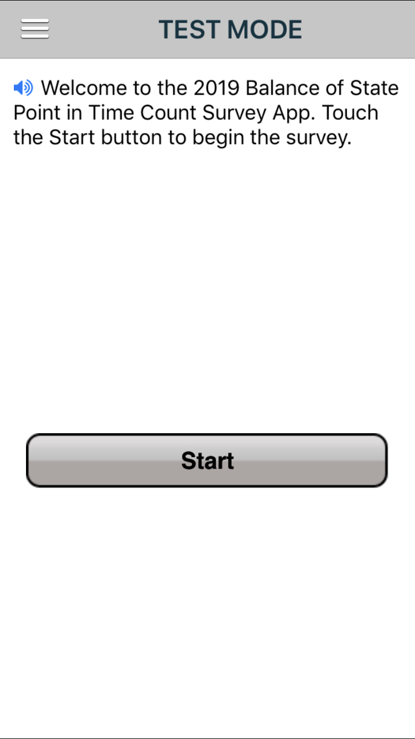
Ready for testing
Click Start to begin the survey
Each survey page has this symbol which is the text-to-speech feature. It will read the text aloud when pressed.

Slide 19
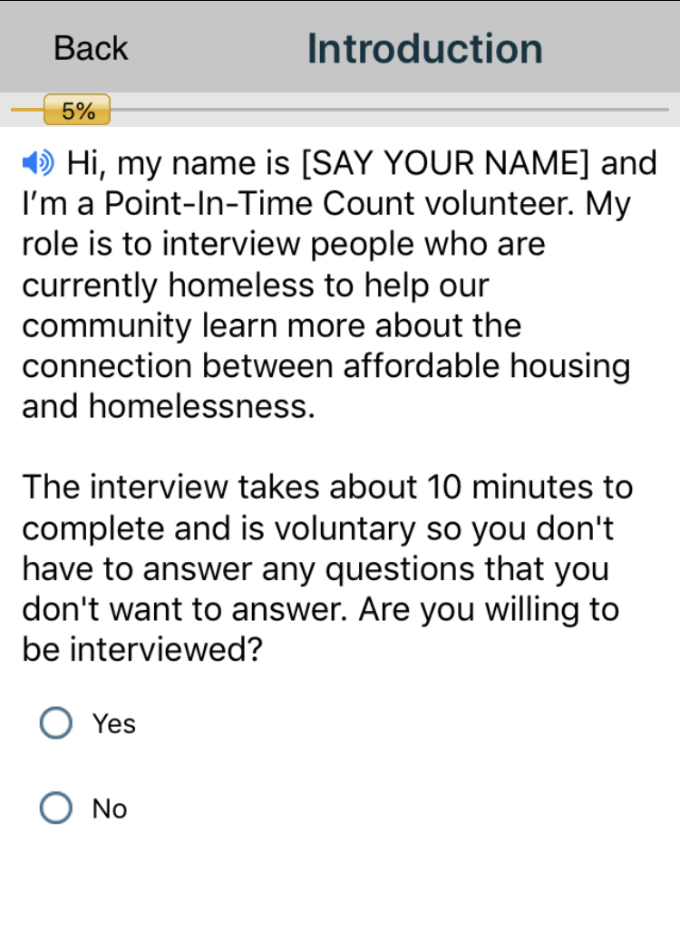
Introduction
This survey is optional so each person interviewed has to give their consent
Helpful scripts are included throughout the survey to make it easier and quicker to use
If the person declines the interview, then click No to end the survey
Notes:
Use Next and back buttons to navigate through the survey.

Slide 20
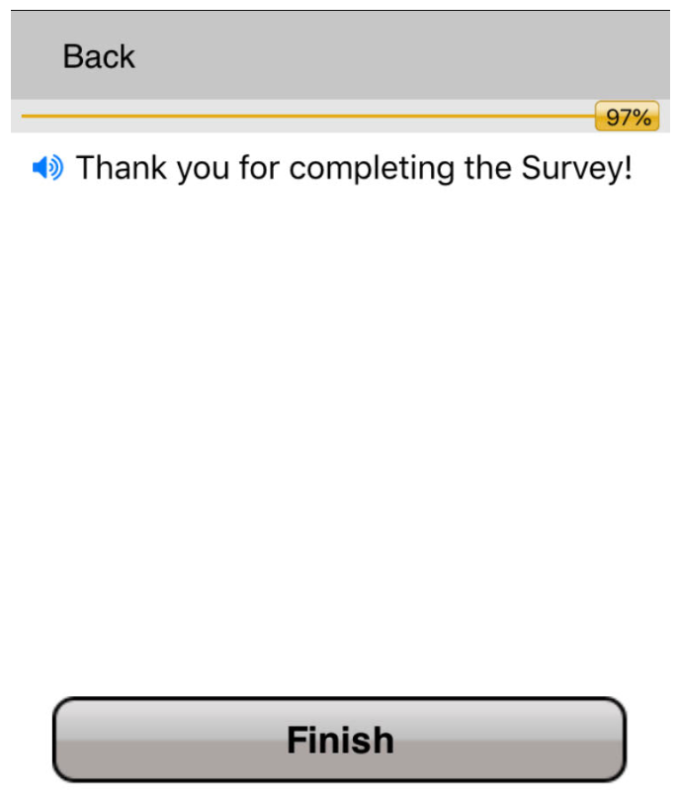
Finished survey
This is the last screen for each completed survey
Don’t forget to thank everyone for taking the survey!
Click Finish to move on to the next survey or to upload to the data center

Slide 21
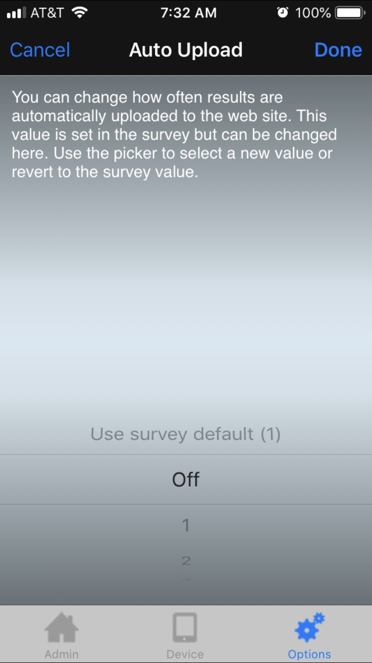
Disabling the auto upload
You may want to disable auto upload until you’re ready to upload all of the surveys
Go to Options screen to adjust your settings

Slide 22
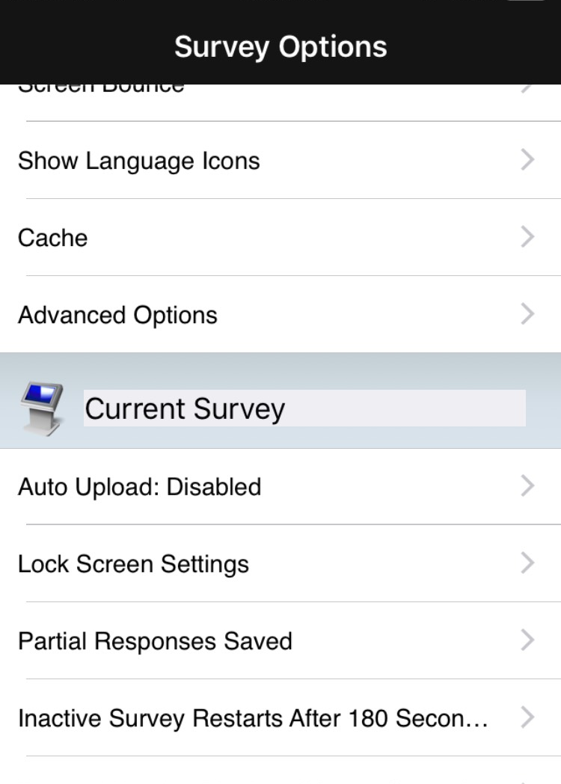
Disabling the auto upload
This is how it appears in your device

Slide 23
Test, test, test

Slide 24
ncceh.org/hmis access local support for Balance of State, Durham, & Orange CoCs
919.410.6997 or hmis@ncceh.org helpdesk for local support

